Slide 1
Innovative methods in mathematics
Daiga Udrase
Teacher of Mathematics

Slide 2
Lessons in nature (I)
Theme of the lesson– Volume
Aim of the lesson- calculate how many m³ of wood is in each
Form – 8^{b}
https://www.youtube.com/watch?v=GGJ7f-Rd9fM

Slide 3
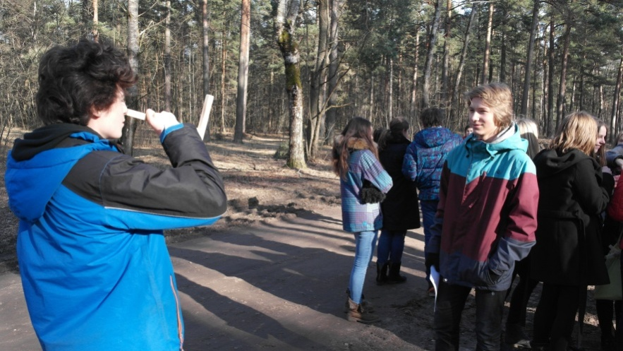
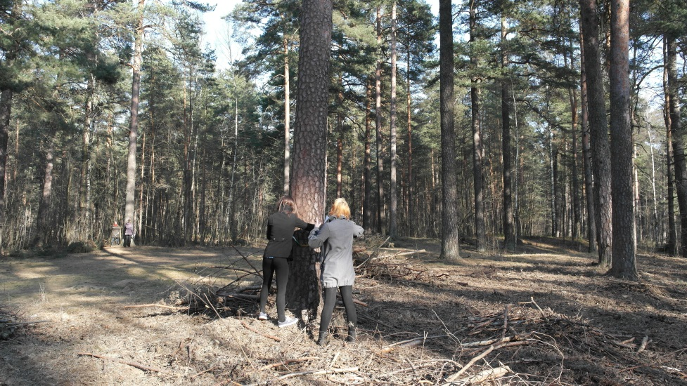
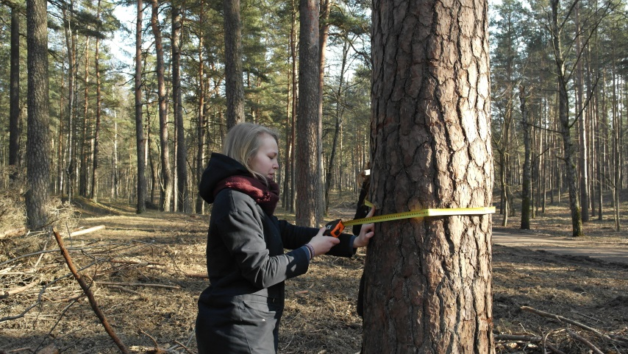
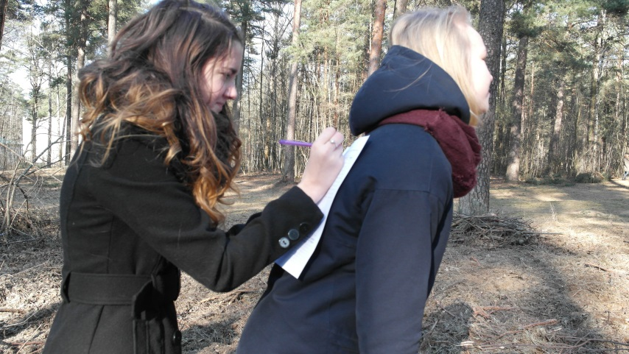
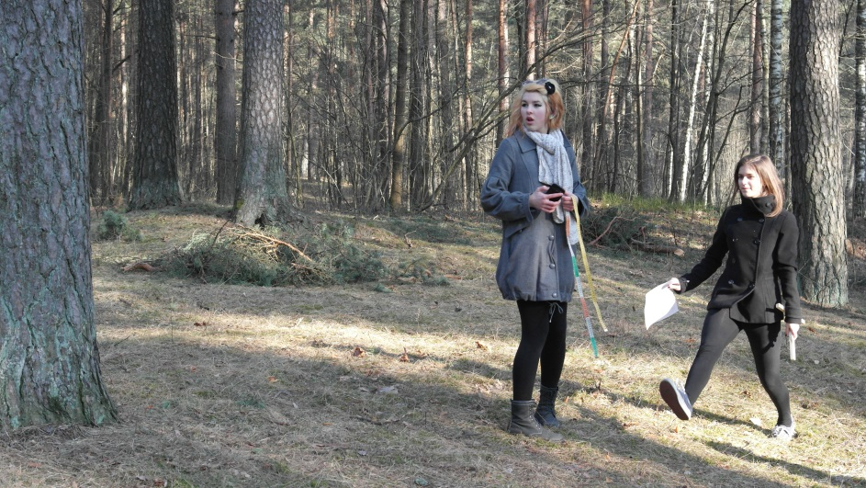

Slide 4
Lessons in Nature (II)
Integrated lesson in cooperation with forms 3^{c} and 9^{b}. Subjects to learn– Latvian, nature science and maths.
The mobile application was used to measure the length of tree. https://www.youtube.com/watch?v=RpxzQrM5mCE

Slide 5
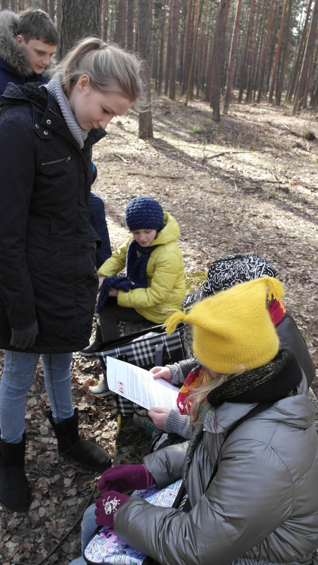
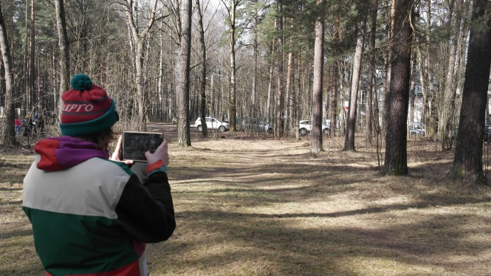
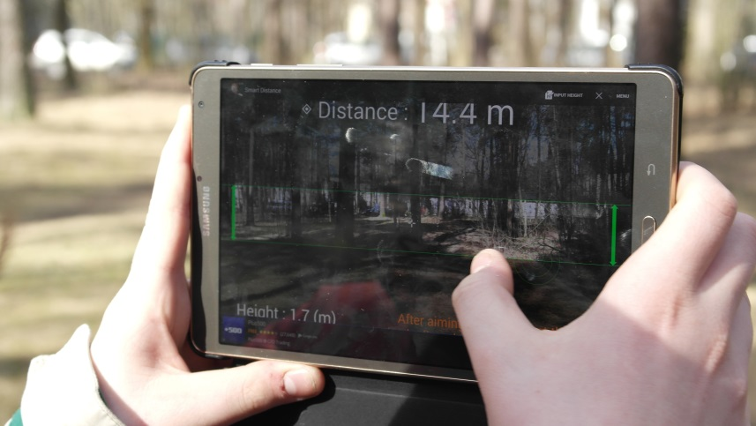
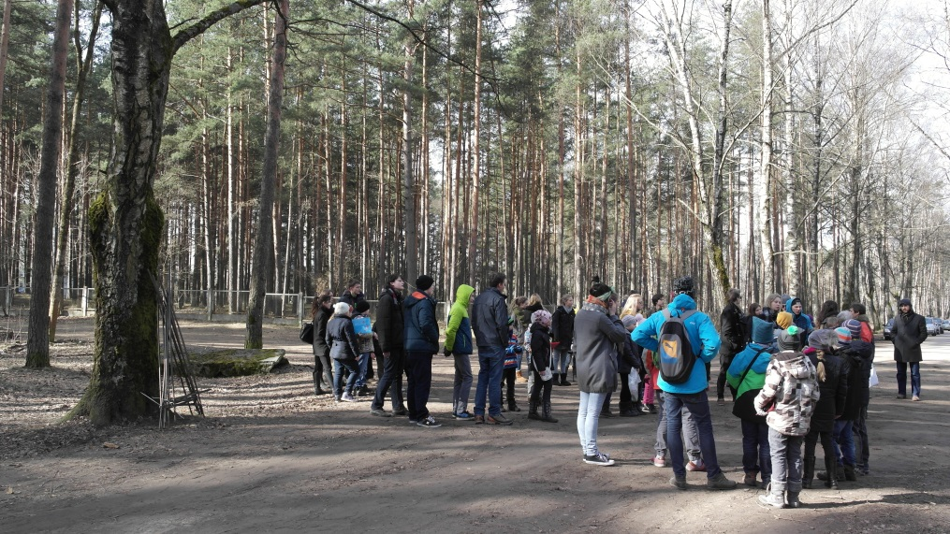
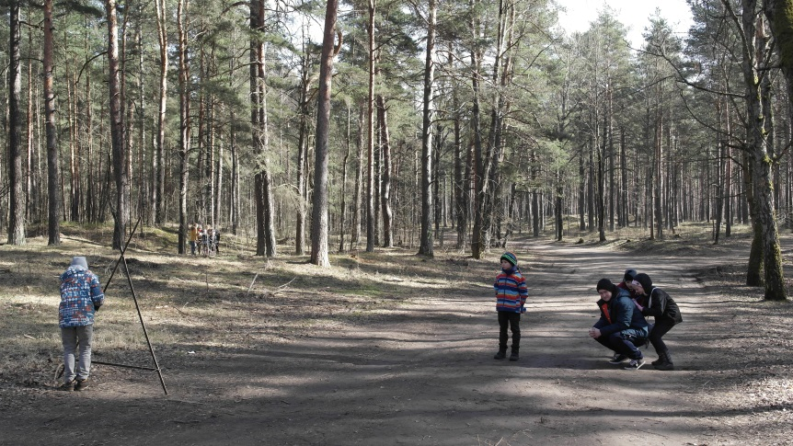
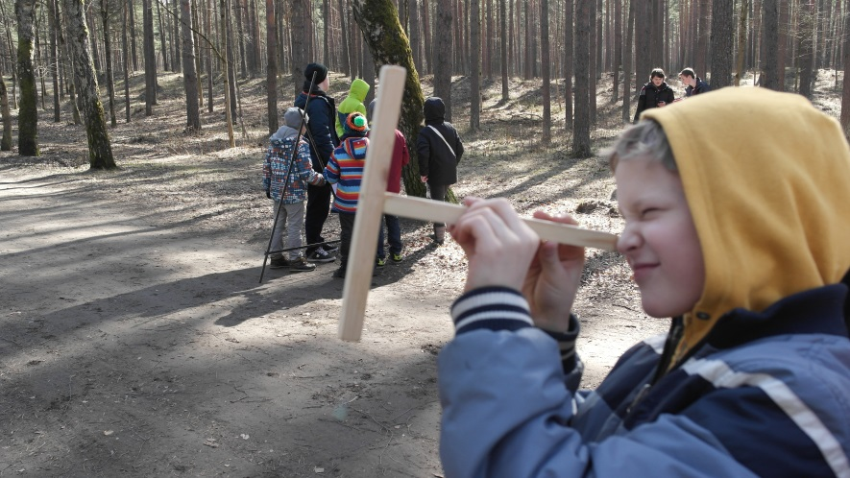

Slide 6
Lessons in nature (III)
Theme of the lessons– identic and equivalent figures
Aim of the lesson– to understand the difference between the identical and equivalent figures by doing practical tasks
Form – 7^{c}
During the lesson students had to film and then had to make a video including the answers to the questions.
https://www.youtube.com/watch?v=hFFZvxBfp64

Slide 7
Students’ videos
Theme of the lesson– linear function
Students make their own videos, where they solve and explain the solution of the problem.
https://www.youtube.com/watch?v=Aq5EVegLhRM

Slide 8
Some more students’ works
Linear function
https://www.youtube.com/watch?v=y1a42J8CpTg
Solution of system of equations with insertion method
https://www.youtube.com/watch?v=wtE-WRg--BY&feature=channel_video_title

