Slide 1

Applying innovative methods and creative approach in English lessons within the framework of the project mobility to Kilimli primary school, Turkey
Study Year 2014/2015
EVITA MACULĒVIČA,
Teacher of English

Slide 2
Innovative approaches
As one of the aims visiting Kilimli primary school was to find out the approaches how to work with students of different levels in English, particularly very talented or students with poor abilities in English, then a special attention was paid to how to motivate and make students interested in English and above all, initiate their speaking skills as this is one of the main aspects evaluated both in exams after form 9 and 12.

Slide 3
1. Work with mobile devices
This was one of the main teaching tool as this ensures that pupils can work on their own paste, thus they do not hesitate from each other and are not afraid to make mistakes. For this purpose the mobile PC class was used and different training programmes for practising grammar task at different levels.

Slide 4
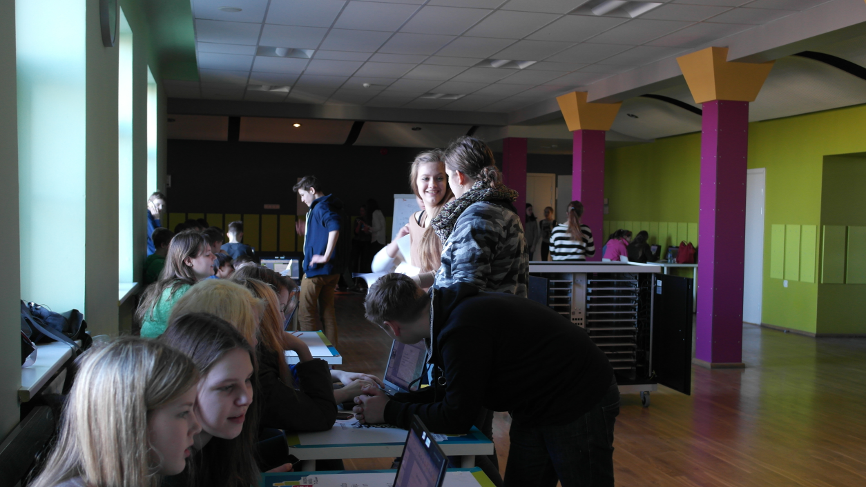
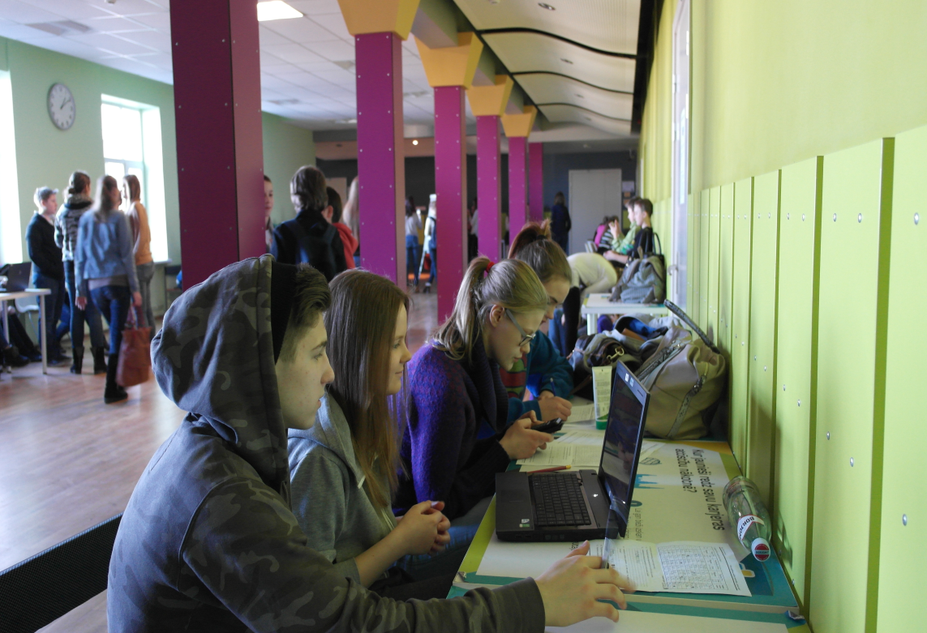
Working with mobile computer class

Slide 5
2. Designing materials with Classflow
Classflow is a specially designed programme which allows to create interactive material to work in class with mobile devices such as phones, PCs and etc.
During this study year I have tried to create some material for students in English literature, e.g. Shakespeare, history about the UK, clothes (for younger pupils).
Sharing the created materials within the Classflow with other teachers.

Slide 6
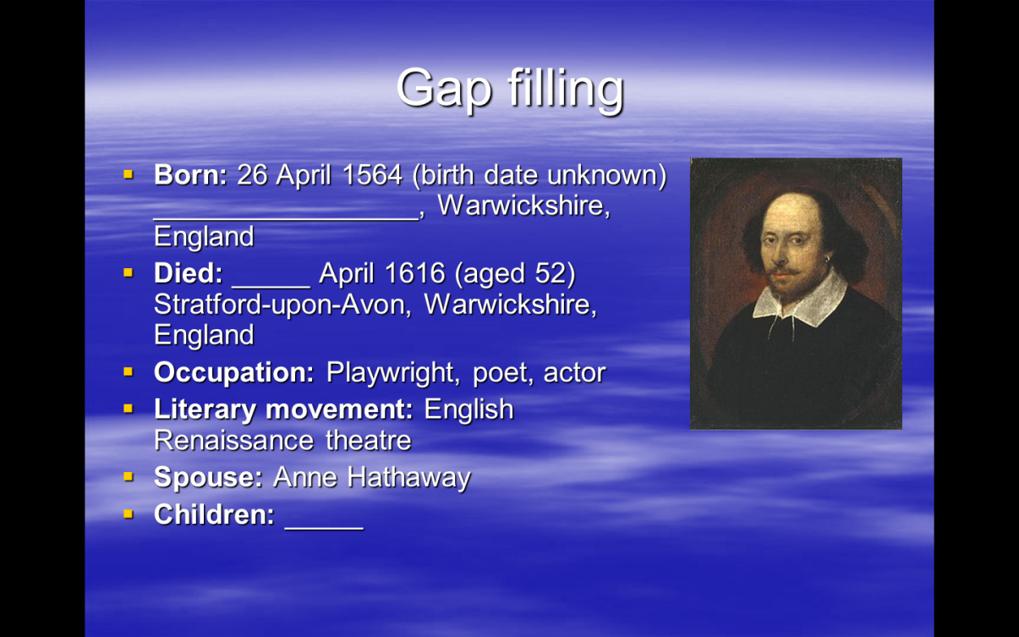
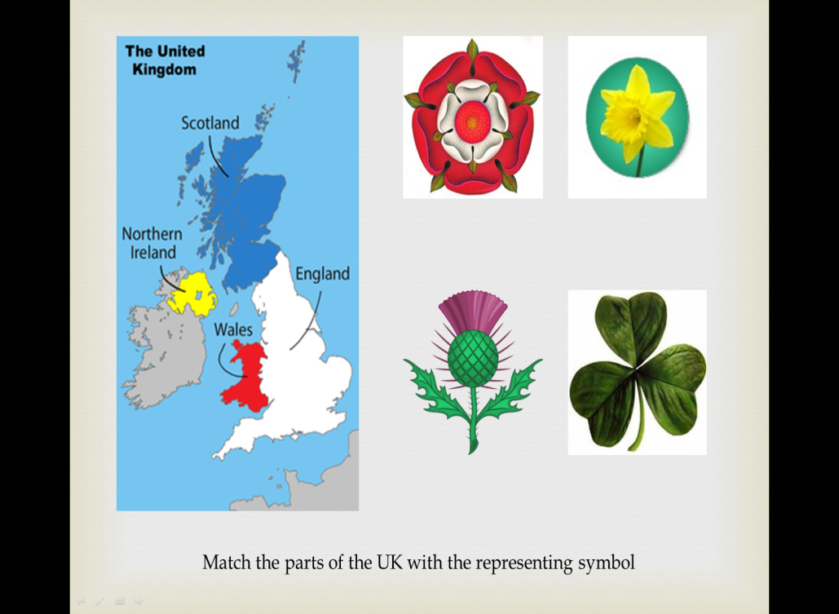
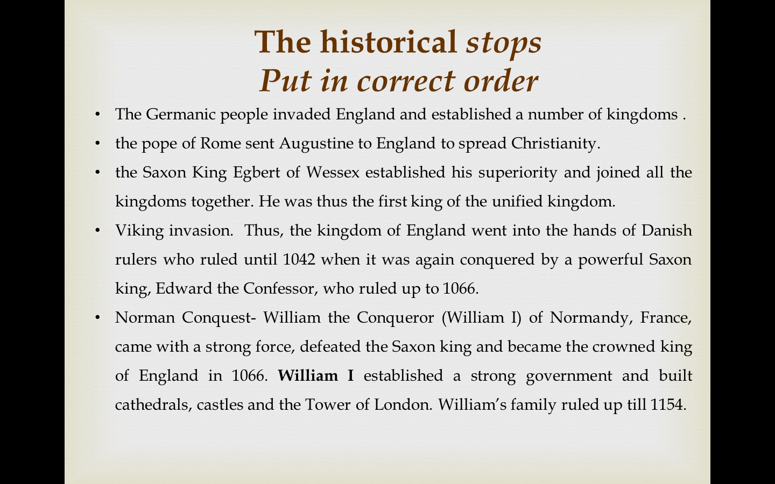
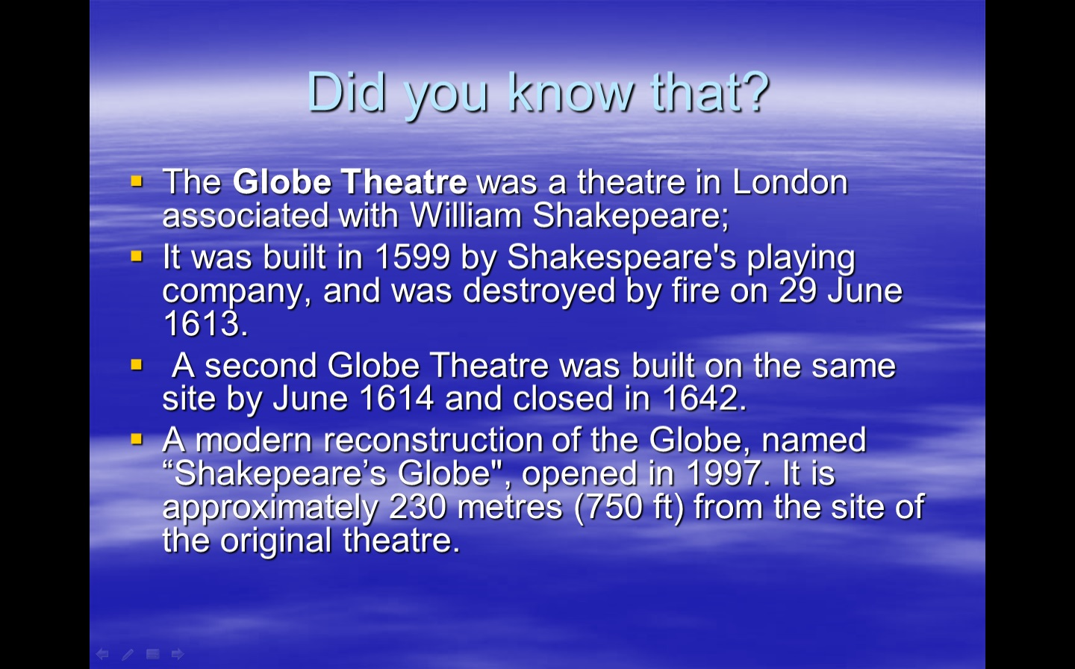

Slide 7
Creative approach
Another important aspect I have worked at is to find creative ways of teaching English in order to motivate students and stimulate their interest about the surrounding world, in particular, different cultures, views.

Slide 8
1.Discussion based learning
Discussion based teaching/learning is a speaking skills developing approach with allows students even with the poor knowledge to initiate the conversation and express their opinions, as they are allowed to get ready in advance.
The topics covered this study year:
1.Life in the EU;
2.War and peace;
3. Our lives after 100 years;
4. Family life;
5. Different cultures.

Slide 9
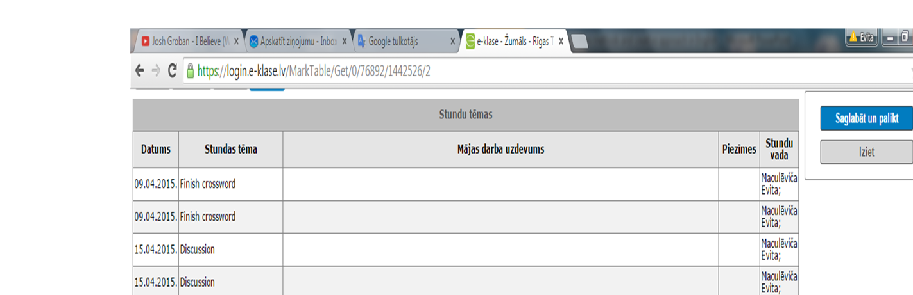
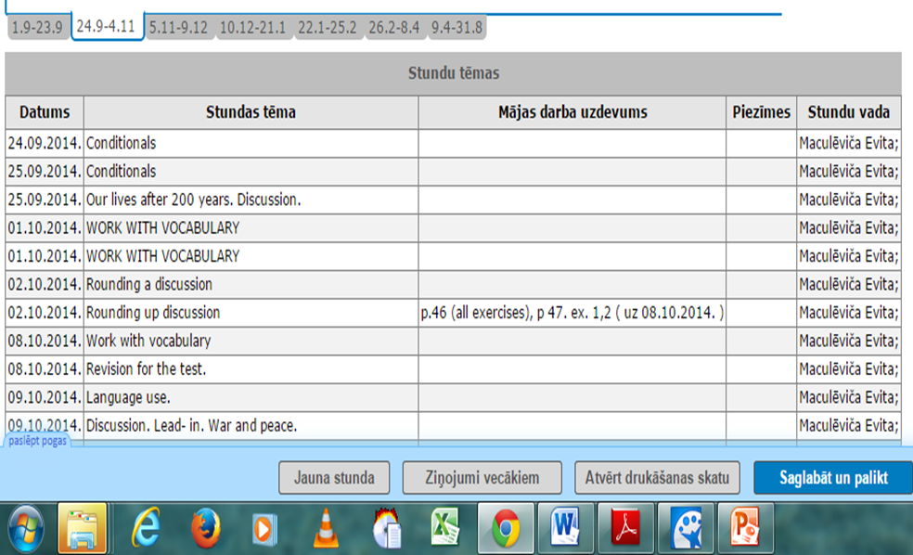
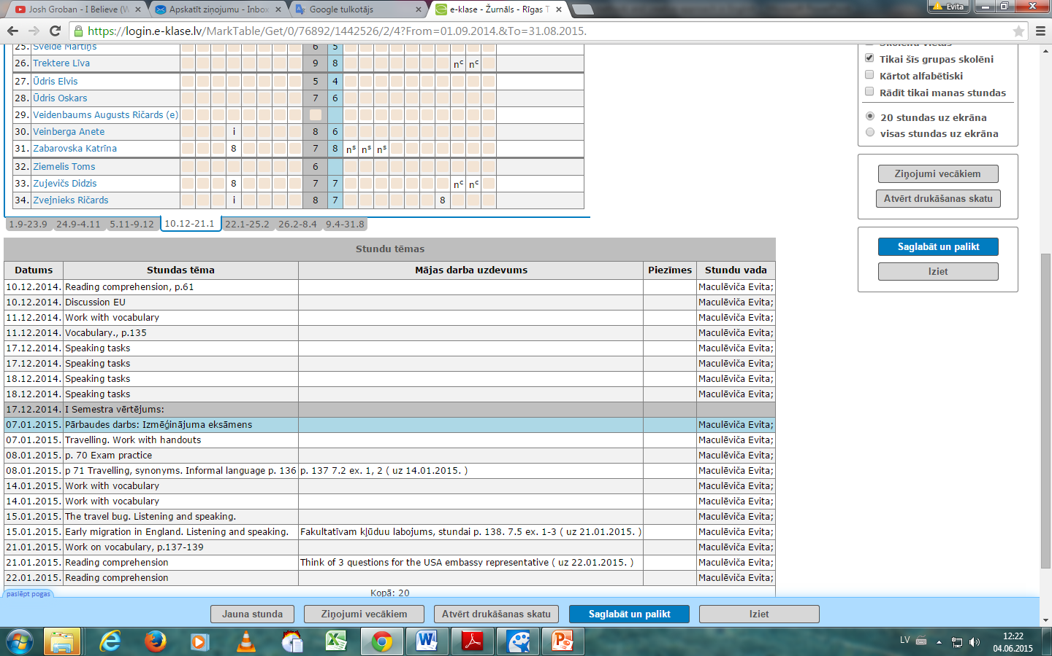
Print screens from electronic register

Slide 10
2. Selection of visual materials
In order to initiate the conersation in the class it is very important to find a stimulus that coul ‘force’ pupils speak. The selection of such material is very difficult as it involves many factors to be successful like emotionality, clear messege, thought provoking. For such purpose I have selected different documentaries available on channel ‘youtube’, which serve as the initiator for the discussion.
The documentaries watched:
Too young to wed
Vice News. Islamic State
Fast food documentary
Banged up abroad

Slide 11
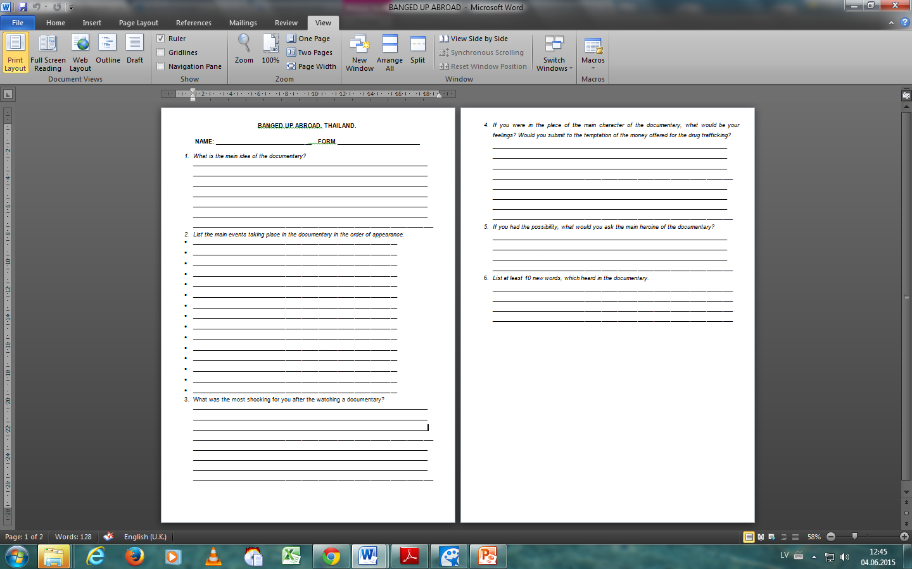
Preperation handout for the discussion Banged up abroad

Slide 12
Gains:
Students are not afraid to initiate conversation;
Students are encouraged to participate in classroom actively and are able to make mistakes;
Students are able to express their opinions on different topics;
Students are more motivated to learn language due to technology use in the classroom;
The academic performance has improved.

