Slide 1

Innovative methods in
English lessons
1. Making a video about a popular animation film in a group
2. creating a commercal about a book
Created by English teacher
Liena Driba
Riga Teika secondary shcool
2014/2015

Slide 2

1. Making a video
The aim & objectives
Based on a popular animation film change and create one new episode.
To develop creative thinking;
To improve communicative competence.

Slide 3
The background information
Class 6
Age 11-13
1 months for preparation
Groupwork
size of group 3-5 students

Slide 4
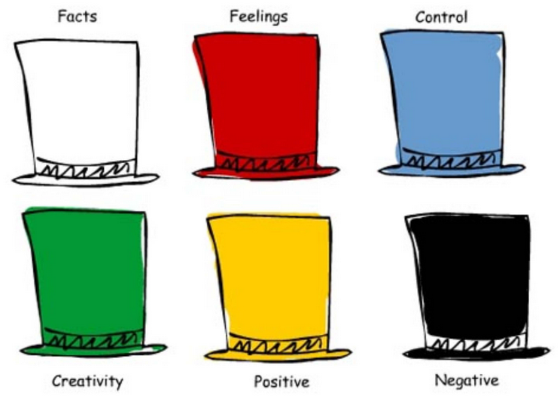
The procedure of the method:
Explaining the goal and tasks;
Warm – up activities;
Using Edward de Bono six hats

Slide 5
steps to make the video
Choose, Watch, agree how, change, take the video, give the feedback
The students in group choose one animation film;
They watch it and consider which episode of the film they want to change;
Discuss and agree how they want to change the episode;
They take the video in groups;
Giving the feedback.

Slide 6
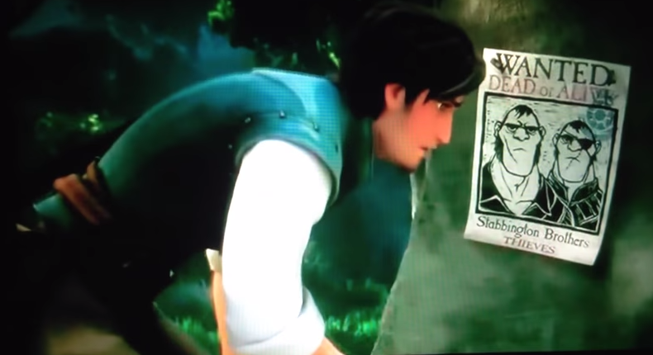
The results
The created video form movie «Tangled»
Presented by
Gustavs ŽEBERS, Edgars Vītiņš, Roberts vītiņš and Patriks Sālzirnis
https://www.youtube.com/watch?v=37deEvWzl4M

Slide 7

The created video form movie «madagascar penguins »
Presented by
Madara bimbere, marta rutena, una Zeltina
https://www.youtube.com/watch?v=sZZVj2keoBQ

Slide 8

2.Creating a commercial
The aim & objectives
To advertise a book which is read in English
To improve the presentation skills;
To develop creative thinking;
To improve communicative competence.

Slide 9
The background information
Class 6
Age 11-13
2 months for preparation
Individual work

Slide 10
The procedure of the method
Explaining the goal and tasks;
Analysing pluses, minuses and interesting about reading books;
While reading students make their notes about the plot, main characters and message of the book

Slide 11
Steps to create a commercial
Analysing, reading, attracting, presenting, giving feedback
Analysing a successful and not successful commercial;
Reading a book and making notes;
Thinking how to attract the audience attention;
Presenting the commercial in front of the class.
Giving feedback.

Slide 12
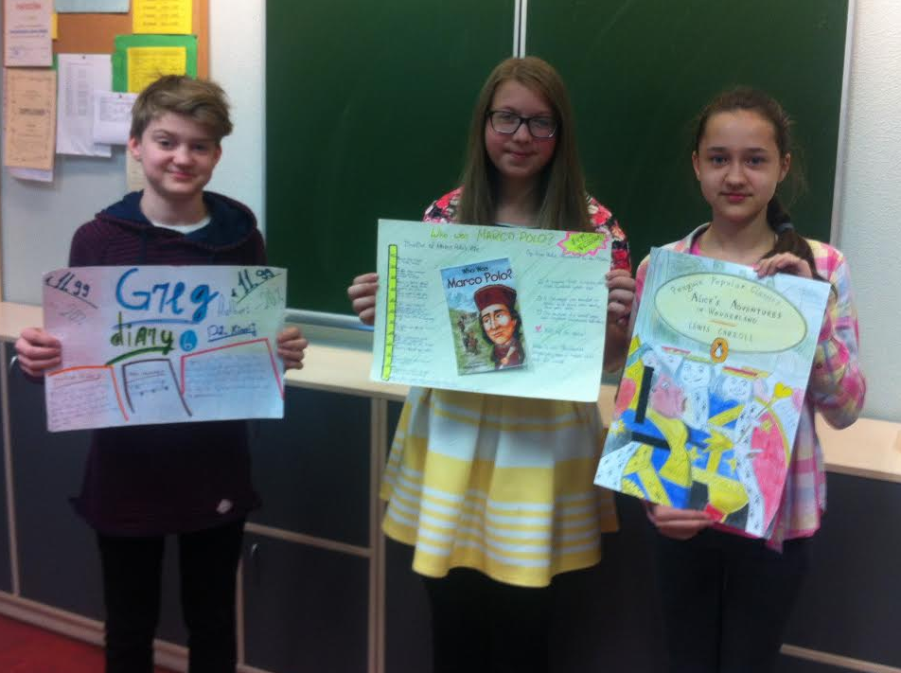
The results

Slide 13
Conclusion
With the help of
creative methods
my students will be more
competitive & successful
in real life☺

