Slide 1

Erasmus+ mobility
Applying innovative methods in English lessons at Riga Teika Secondary school, Latvia
Inese Bugrija, Teacher of English

Slide 2
Innovative methods in English as a foreign language teaching
During the mobility in Germany, various methods of foreign language teaching were observed.
The teacher gained insight into language teaching in Germany and borrowed some activities or inspired from them to create own innovative English teaching activities to apply in Latvia:
  Use of a simple silent video clip for grammar tenses’ understanding and application;
  Cross-cultural groupwork in roles (role plays) to raise cultural awareness and empathy;
  Poetry writing in English classes outdoors;

Slide 3
Innovative methods in English as a foreign language teaching
  Peer formative assessment and analysis of it;
  Acting out spring poems and drawing them from what students hear. Translating them into Latvian.

Slide 4
Silent video clip for grammar tenses
The activity is based on a video and shows students the use of various past tenses.
  Students watch the video and write down the activities they see Mr. Bean does during the video;
  The activities are written down by the teacher on the blackboard.
  Students read the rules of tense application from the textbooks.
  Teacher asks about the type of activities – which are long and background activities (Past Continuous), short and ended (Past Simple), preceeded by other (Past Perfect). Students write description of the story.
  Video: https://www.youtube.com/watch?v=NnaRp0x_kQM

Slide 5

Mr. Bean’s Sandwich making in the park

Slide 6
Cross-cultural groupwork in roles (role plays) to raise cultural awareness and empathy;
  Students work in pairs. One of them is from a big country, another is from a small country. Each of them has to find 3 arguments of the advantages of their country. Later, after a discussion, each of them finds both advantages and disadvantages of their lifes in their countries and what people from both countries can learn from each orther.

Slide 7
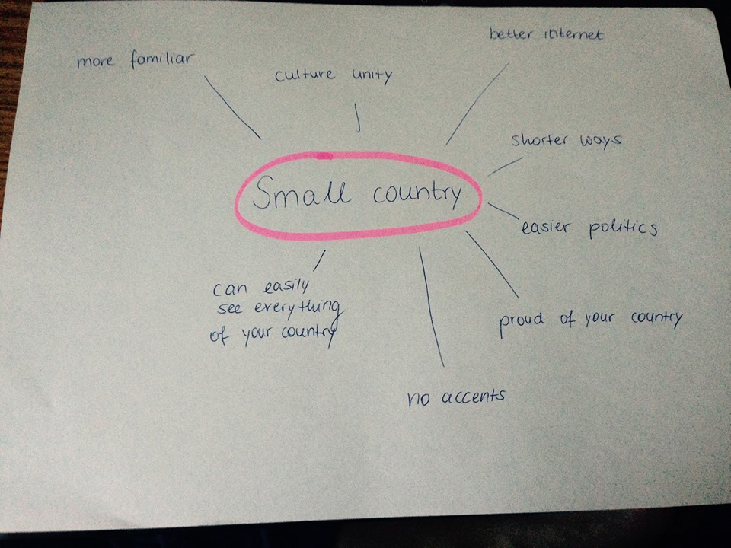
A sample from Students
Summary

Slide 8
Poetry writing outdoors
This activity is a mix of English and Nature Sciences. Students learn both new vocabulary in English and explore the nature around.
  Students go outdoors and find their places for a creative activity.
  It is possible to work individually or in pairs.
  Students can have individual assisstance from the teacher if they need it.
  The use of school’s property (garden) lets students to be safe during the lesson – they are not on the street.
  Students compose the poems and can draw an illustration of it if they feel like it.
  Students later present their poems in front of the class and give their assessment of the activity.

Slide 9
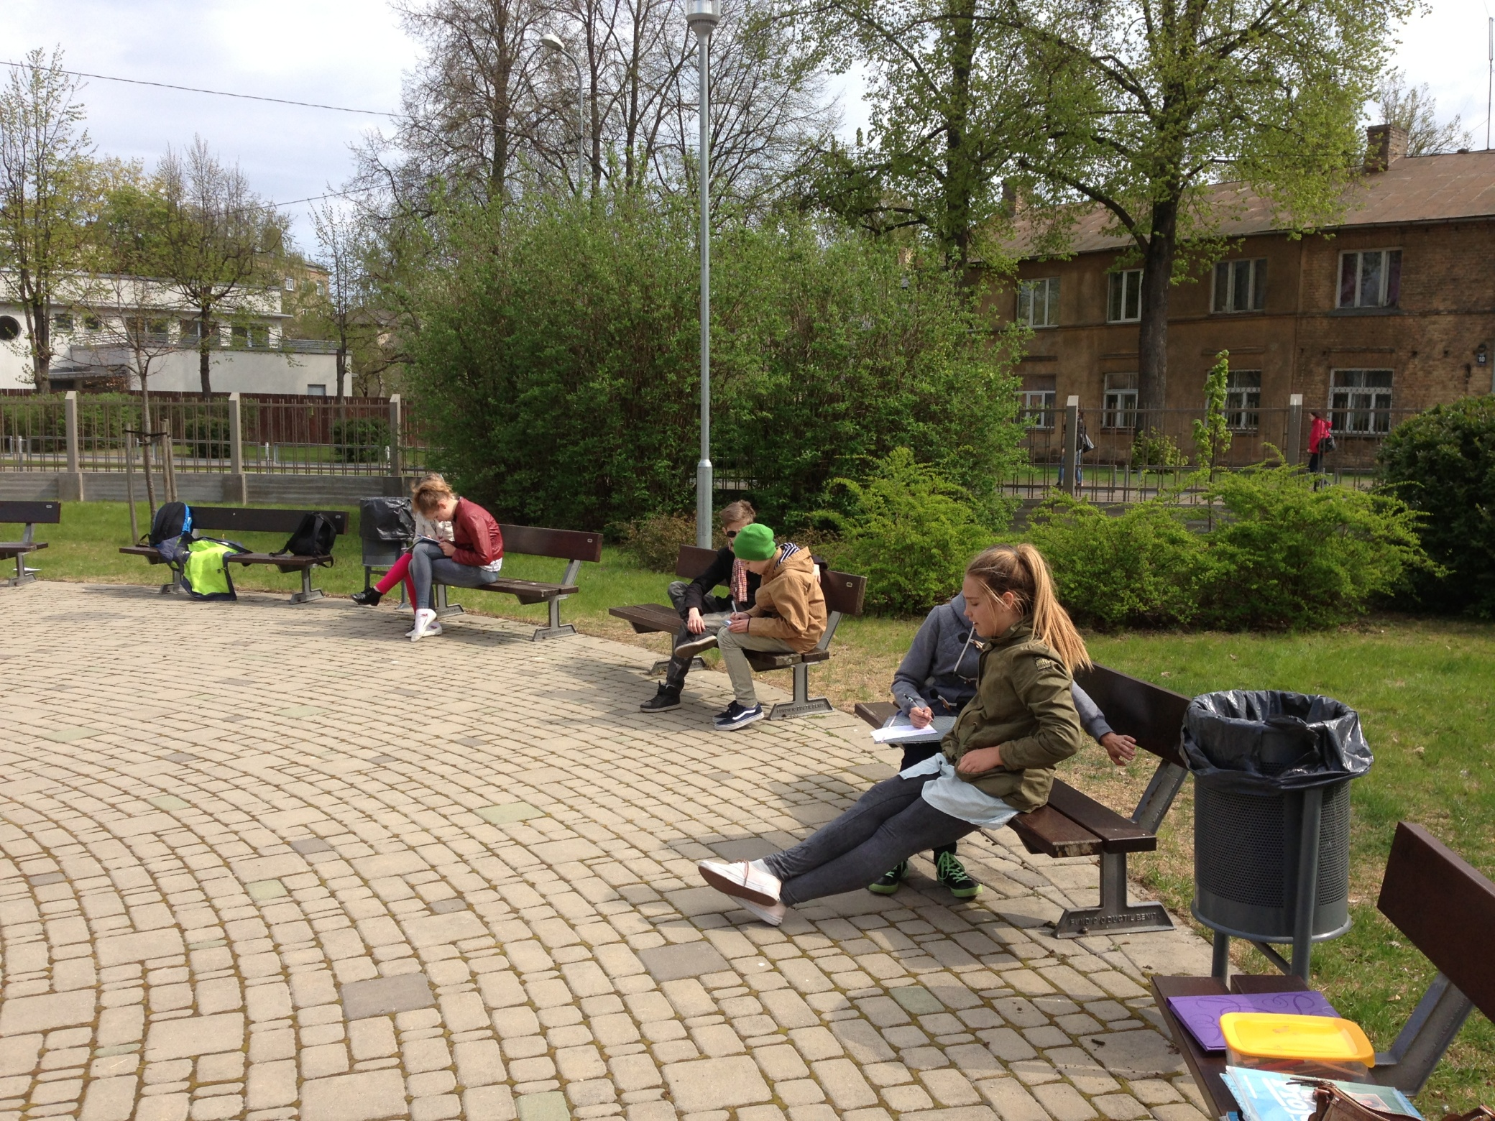

Slide 10
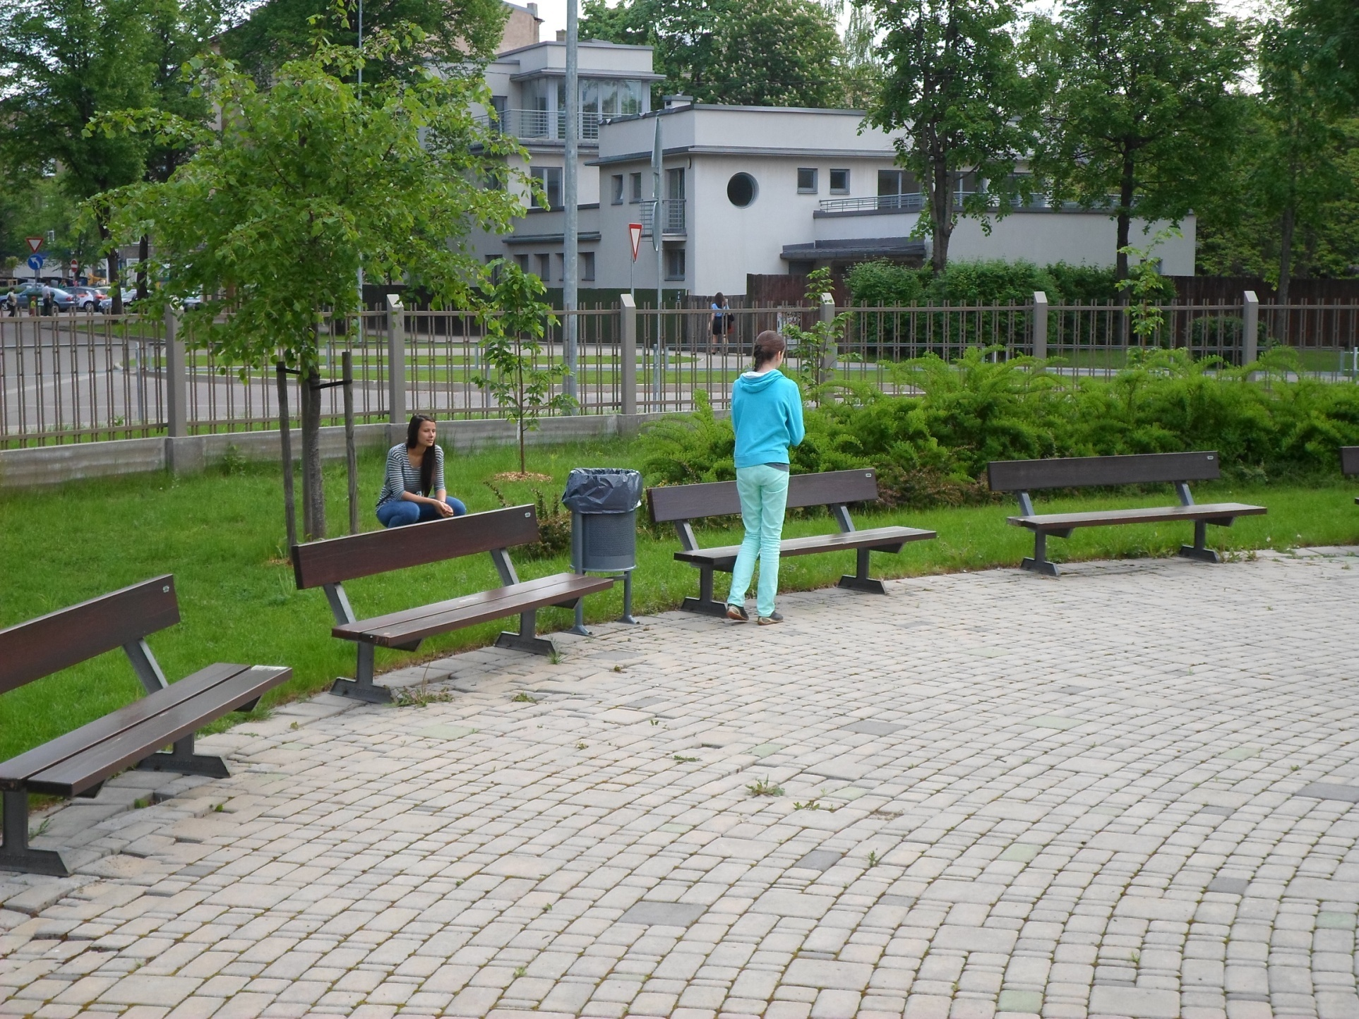

Slide 11
  Acting out spring poems and drawing them from what students hear. Translating them into Latvian.
This activity is borrowed from the mobility in Germany, where students read poems in English. The activity focuses on student’s sense of language and its rhythm. Here, it is also asked to write down the translation of the poem into Latvian, which makes this task challenging and at the same time can be done individually at an individual pace and with the help of a dictionary.

Slide 12
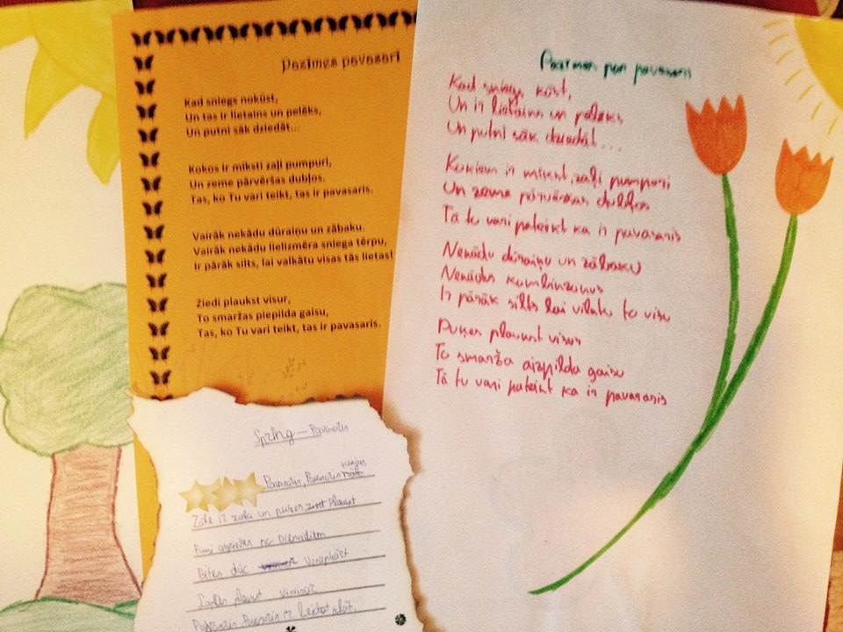

Slide 13
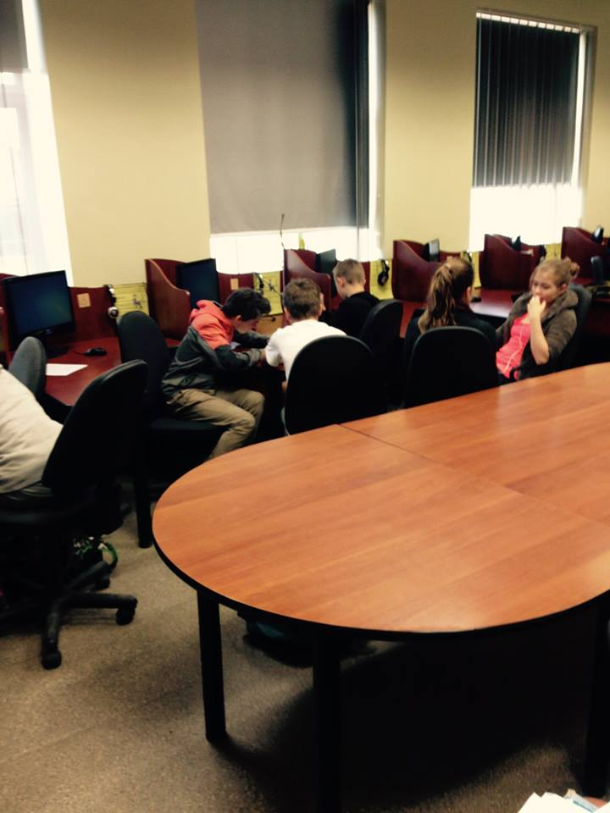

Slide 14
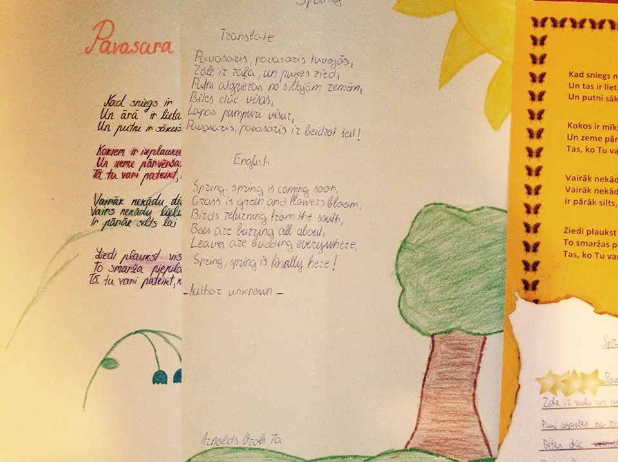

Slide 15
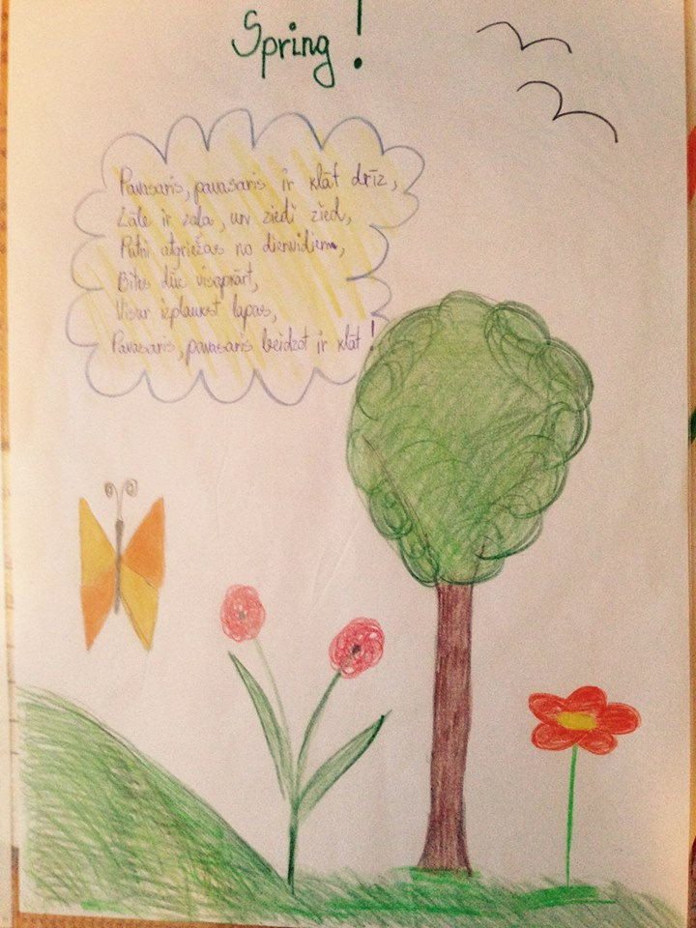

Slide 16
Summary
All the activities include creativity. Language learning is a creative process and therefore creativity fosters language learning. It also increses student’s llevel of motivation in the learning process.
Students like practical application of the activities. Poems, group discussions and their analysis, video watching with grammar neuanses – everything with pictures, colours and different movements raise student’s interest and learning progress improves.
Upper-secondary students also need application of videos and funny situations to maintain their interest on difficult topics, including grammar.

Slide 17
Summary
Students are willing to express their opinion about activities and their learning progress. They can assess their learning quite clearly if they are sure they will be listened to.
Students are open to experiments and innovative methods. Even though it takes more preparation time, teachers should be urged to invent and try out new innovative methods to improve their teaching experience.

