Slide 1

Erasmus+ mobility
Europaschule Rövershagen
Rövershagen, Germany
22.02.2015.-28.02.2015.
Inese Bugrija, Teacher of English
Lauma Salmane, Teacher of Nature sciences

Slide 2
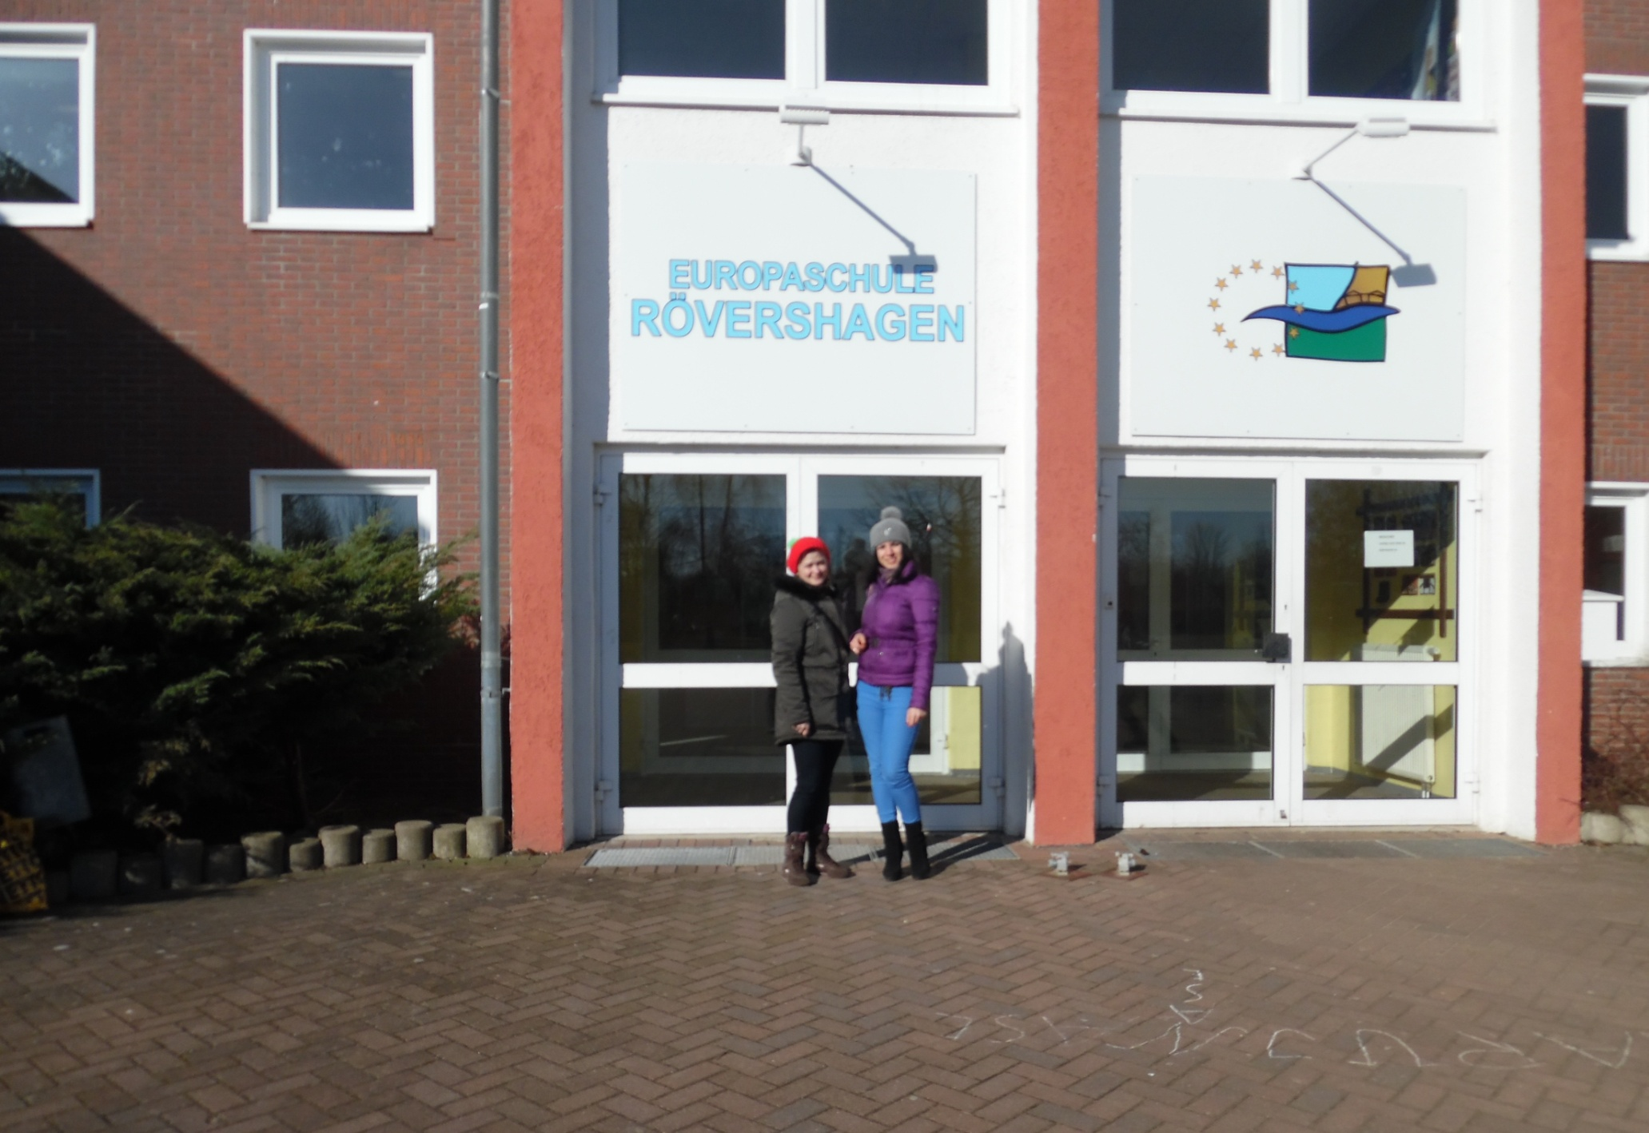

Slide 3
Program of the mobility period:
1. Mobility period planning in the Sending institution (February 2 – February 20)
2. Arriving in the Host institution in Germany (February 21- February 22)
3. Practical application of the planned activities and observation practice (February 23- February 28)
4. Leaving the Host institution (February 28)
5. Arriving back in Latvia (March1)
6. Result analysis, presentation in the Sending institution, application of the innovative methods (March 2- March 13)

Slide 4
Preparation stage
A thourough research of the latest literature and teachers web sites, blogs and channels bring more insight into the latest innovative approaches and methods used in language and nature sciences education;
The teacher of English is writing her Master’s thesis about oudoor activities appllied in primary and secondary school language education, therefore these methods will be also questioned, prepared and if possible tried out during the mobility;

Slide 5
Students in Latvia are questioned about their opinion about a modern language and nature sciences education and their opinions are brought as well to the receiving organization where students are also asked to express their opinions;
In order to carry out teaching praxis it is necessary to find out more about the national qualities of the receiving organization’s country, therefore teachers do some Internet research;

Slide 6
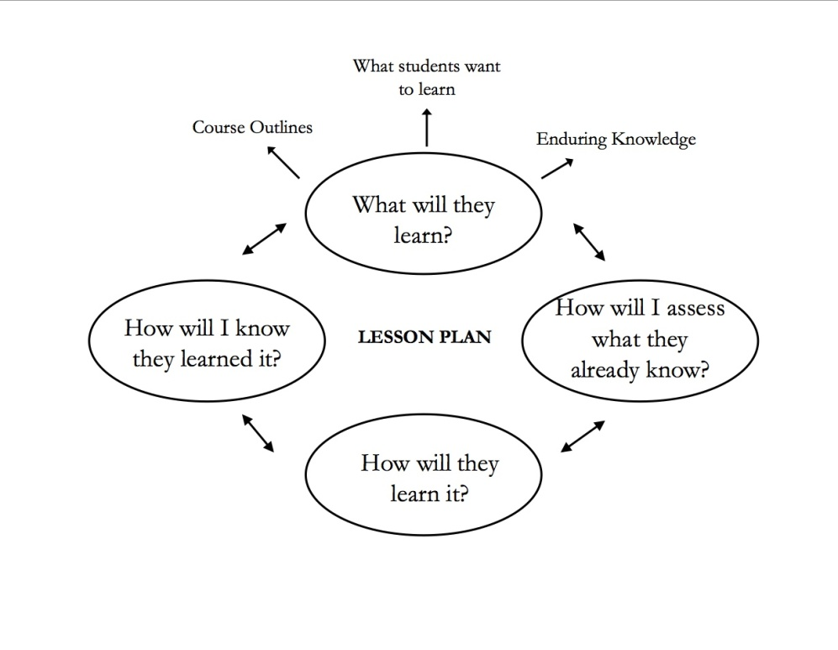
For an effective mobility teachers prepare lesson plans and collect the necessary materials for lesson implementatiuon in the Host organization;
Each teacher prepares
and activity to introduce
his country, give some
insight about Latvia’s
culture, traditions, nature,
people, history and life in
it.

Slide 7
During the mobility
The mobilty was rich in various activities carried out in and outside the school;
Teachers tried out a couple of lessons to show some innovative methods used in Latvian schools.
Teachers participated in all social events and lessons that were carried out at the school at the week of mobility
  Teachers’ meetings
  English and Nature Sciences’ lessons
  Preparation of the school’s play
  Sports competition
  Art exhibition placed at school

Slide 8
Lessons and innovative methods
During the mobility teachers from Latvia observed lessons and carried out their own lessons, trying out various methods.
Nature Sciences
Use of Interactive Whiteboard for species variety introduction;
Use of the Stations’ approach with real life materials;
Creativity Activities in Nature Sciences

Slide 9
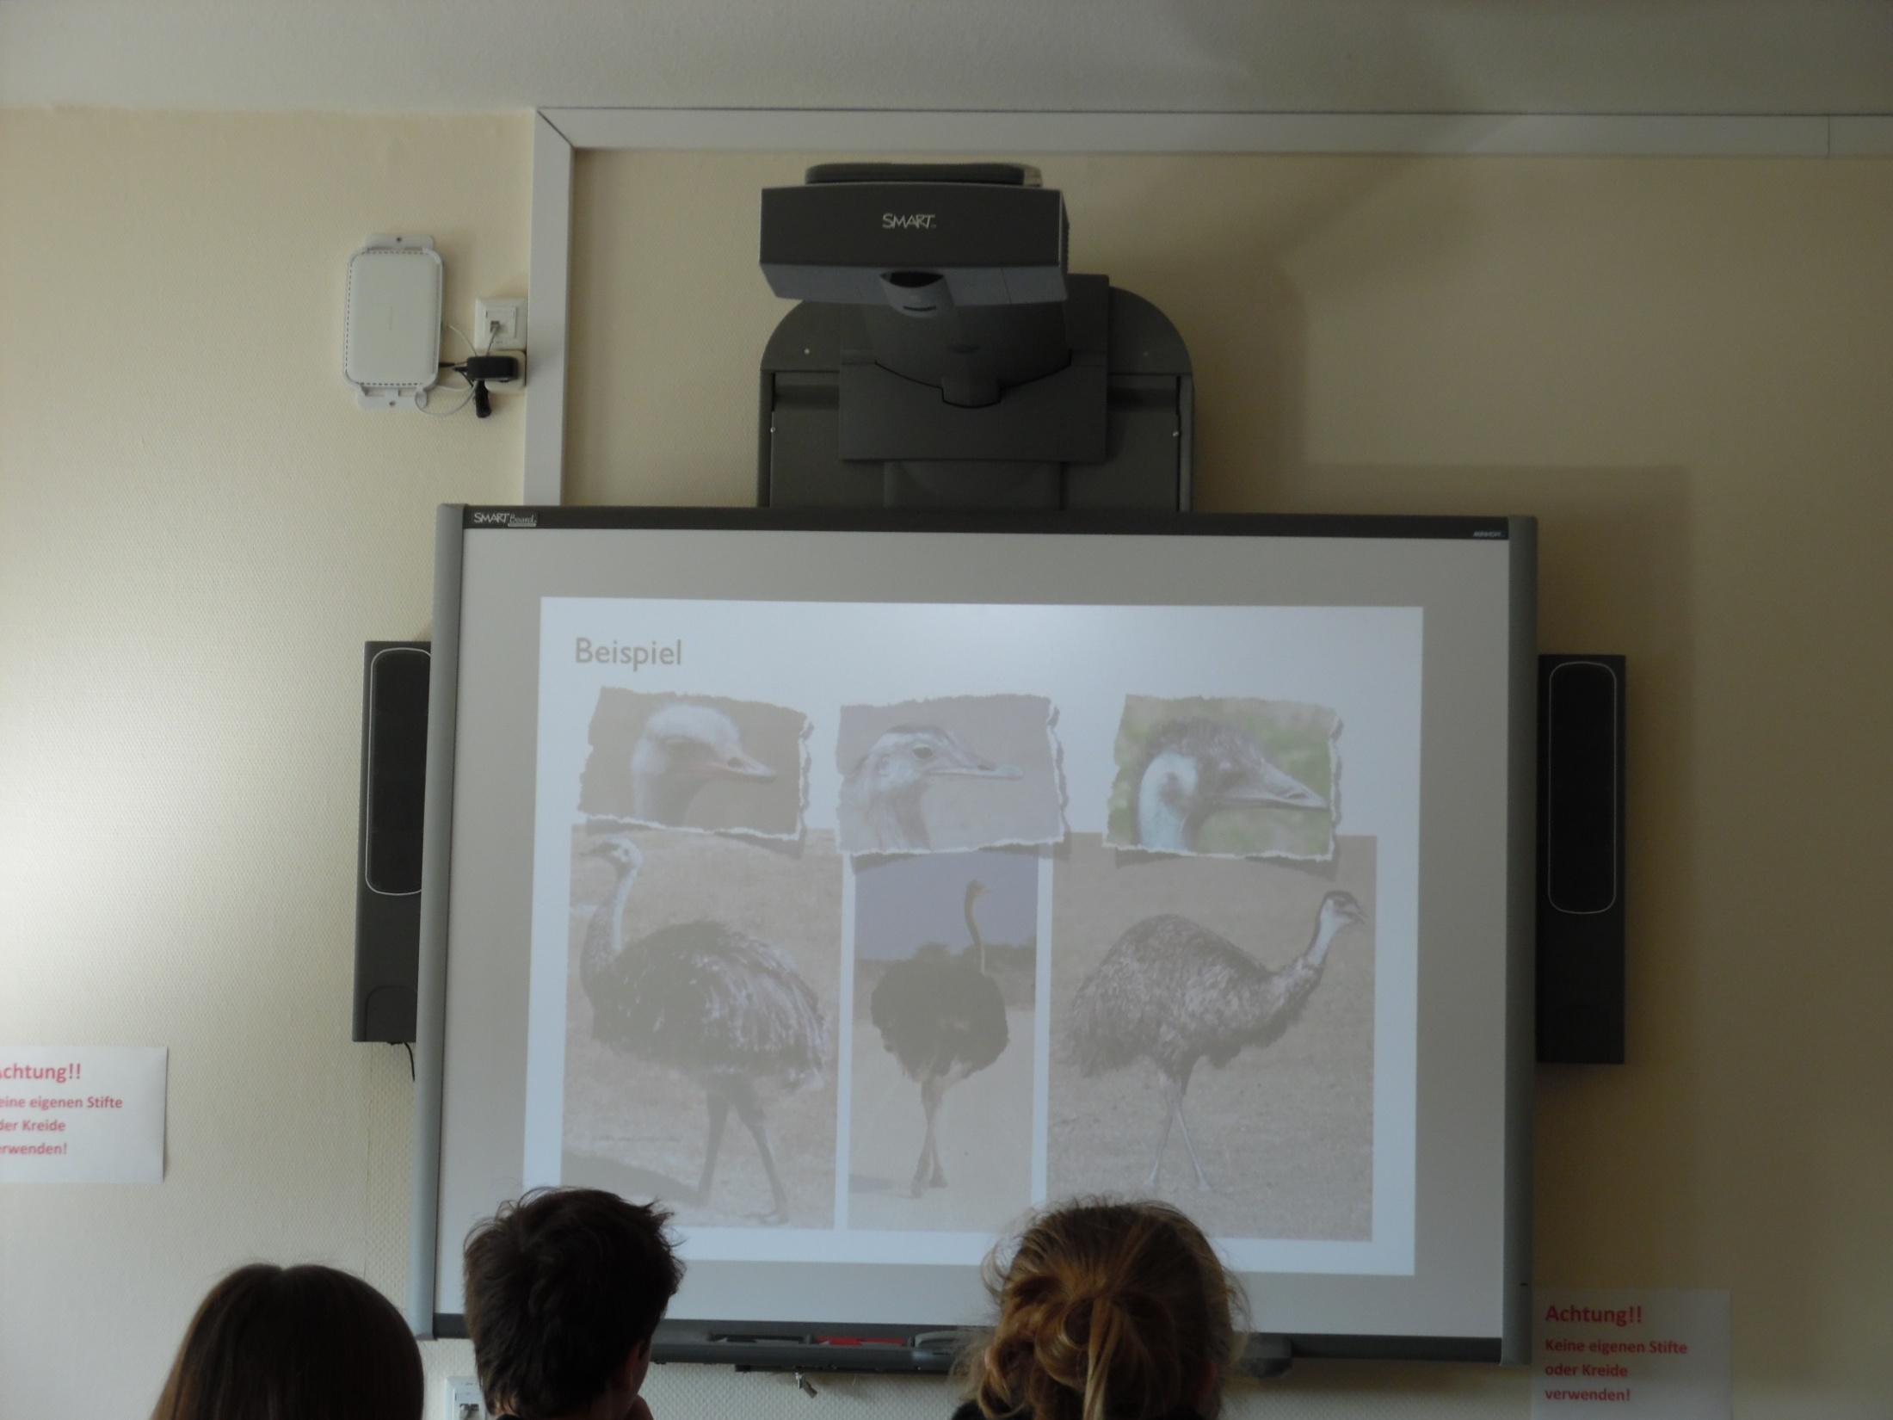

Slide 10
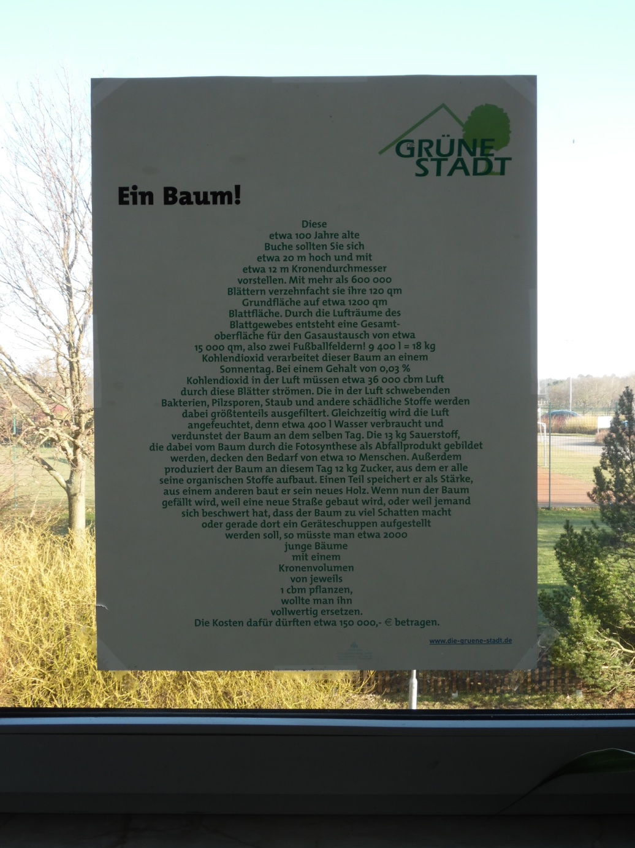

Slide 11
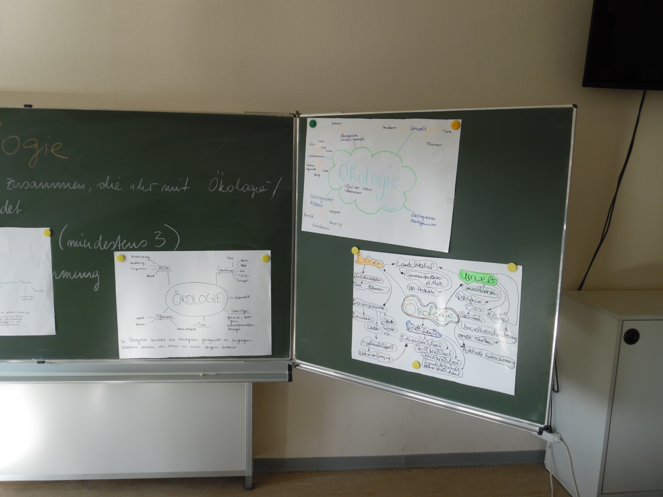

Slide 12
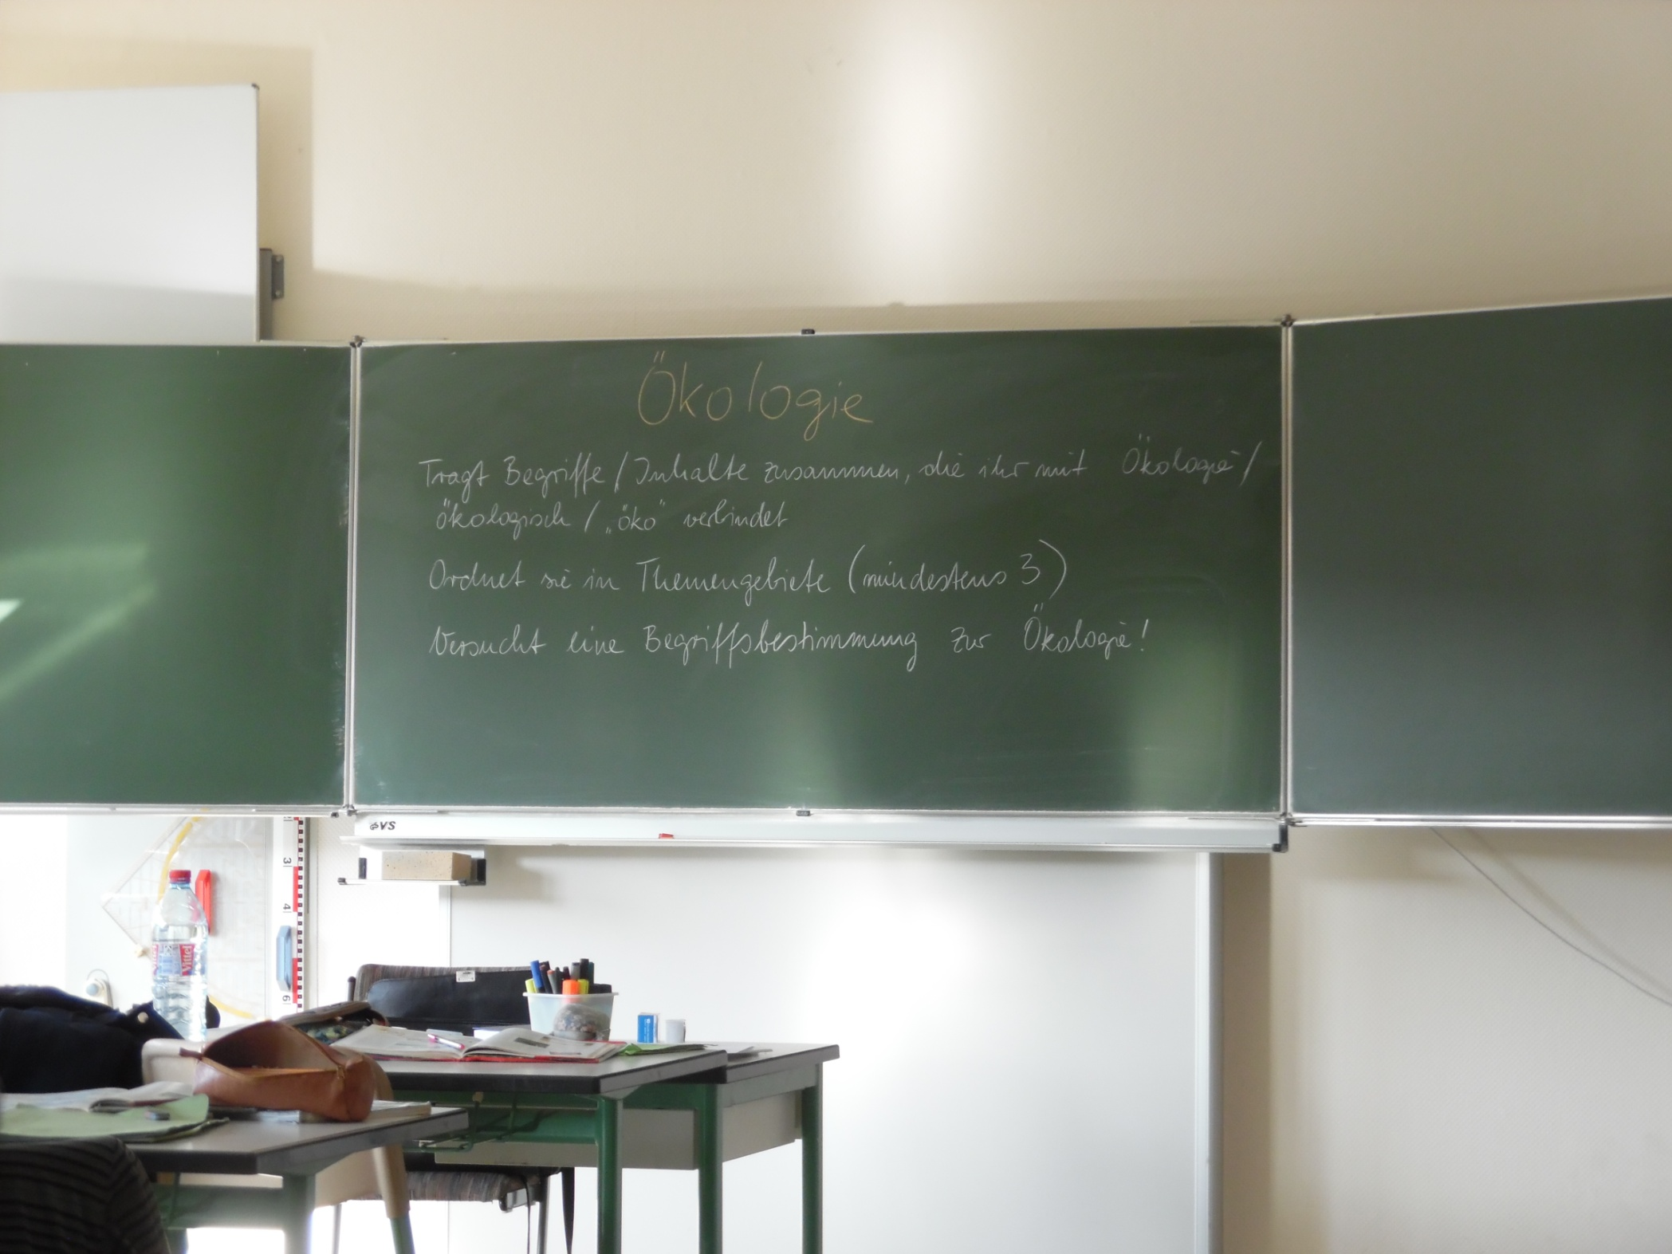

Slide 13
English (as a foreign language)
  Use of a simple silent video clip for grammar tenses’ understanding and application;
  Cross-cultural groupwork in roles (role plays) to raise cultural awareness and empathy;
  Poetry writing in English classes;
  Peer formative assessment and analysis of it;
  Textbook-based imaginatory creative tasks on royals with a purpose to apply conditionals;
  Conversation patterns used for everyday situations and applied in classes.
  Acting out spring poems and drawing them from what students hear;

Slide 14
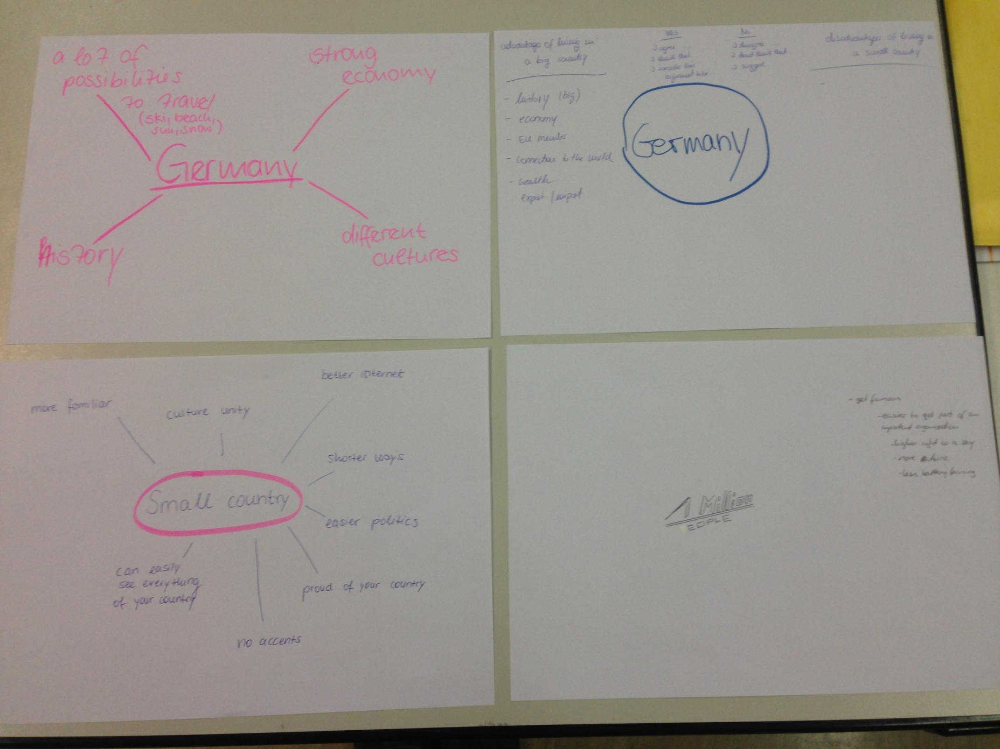
Cross-cultural role plays

Slide 15
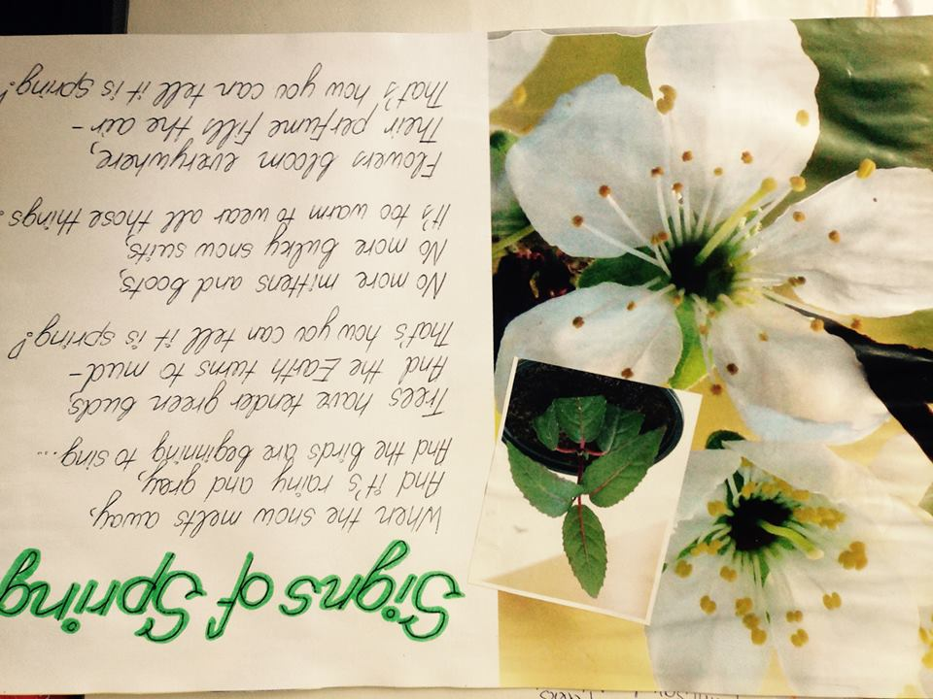

Slide 16
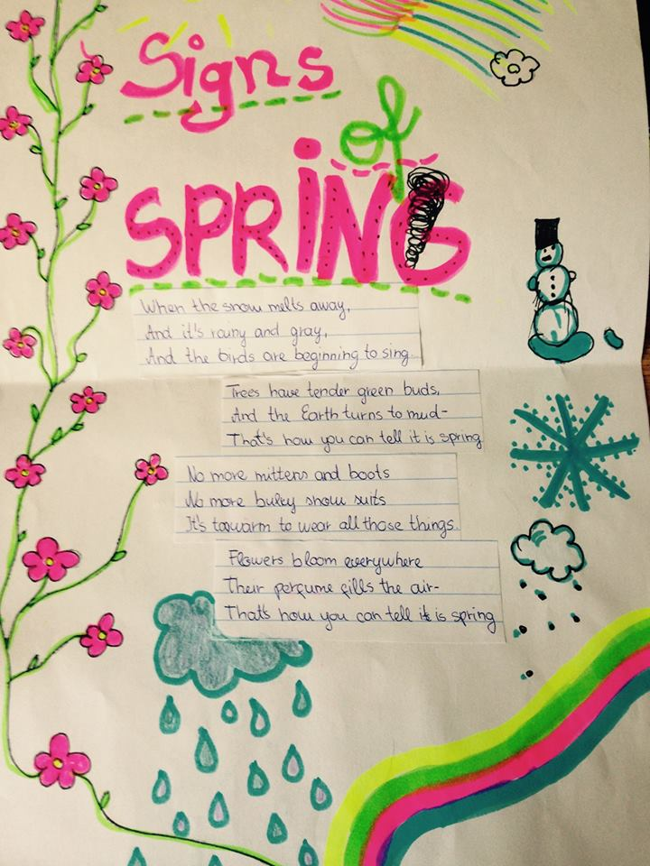
Poem analysis

Slide 17
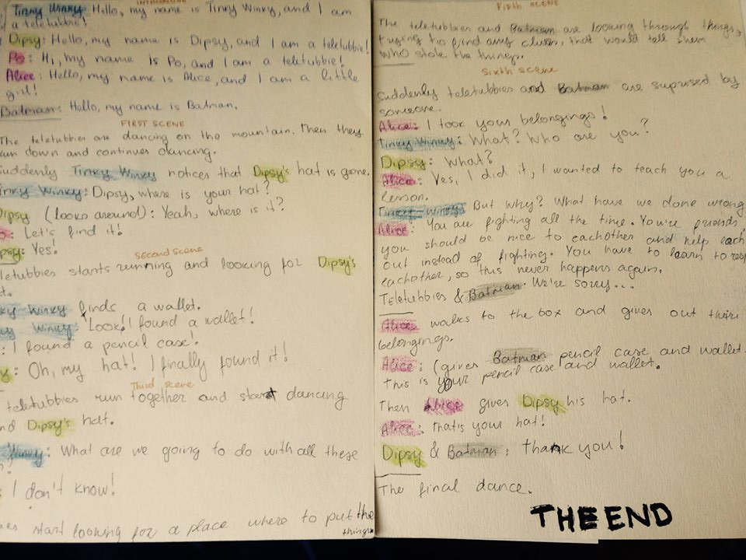
Creative Writing

Slide 18
Competences acquired by the participants
Linguistic competence (German, English);
Teaching skills and competencies (latest innovations in ESL teaching and classroom management, lesson planning, lesson observation, lesson management);
Cooperation competencies (co-work with foreign colleagues, participation in their lessons, lesson discussions and analysis);
Intercultural competence (ability to understand various cultures and their specific needs);
Competence of inclusion and lesson adaption (analysis of host’s current experience and inclusion plans).
Presentation and planning competence during and after the mobility.

Slide 19
Conclusions
The mobility gave Latvian teachers a great insight into German teaching and learning culture, traditions and rhythm.
German schools tend to rely and use less technology. Instead, they focus on writing and duscussions. In Latvia, we tend to pay more attention on the use of latest technologies, which is not always as fruitful as thought.
Creative activities are highly effective for students’ motivation both in Latvia and Germany.
In Germany, lessons tend to be at a lower pace. Students gain more time for individual work and individual consultations.

Slide 20
Conclusions
For Natural Sciences, students are eager to try out new activities with practical application of materials.
Group work is higly dominant. It also promotes inclusion of various students with various needs in the group.
As the school host refugees from Ukraine and immigrants, it promotes their inclusion in the society in a variety of ways.

Slide 21
Suggestions for Latvian colleagues
Use less technologies. Instead, focus on group and pairwork and apply it in lessons.
Ask students about their ideas for the learning process. Apply them in classess.
Invite students to work with thextbooks more thoroughly and use offered exercisesin different ways to give more revision of the material for students who need a different angle to look at things and concepts.
Bring students outdoors during the lessons.
Involve students in study material creation and development.
Invite students to assess their learning in order to improve their study independence and awareness.

Slide 22
Thank you!

