Slide 1
24th-28th November, 2014 Slovenia, Lubljana
TEACHING CREATIVITY IN SCHOOLS
CREATIVITY - THE MOST IMPORTANT HUMAN RESOURCE OF ALL

Slide 2
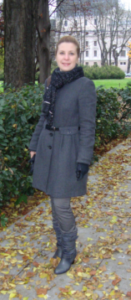
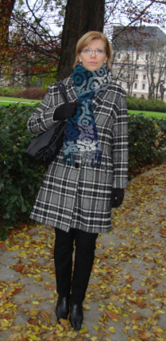
The participants from Riga Teika secondary school, Latvia
Liena Driba Kristīne Salnāja

Slide 3
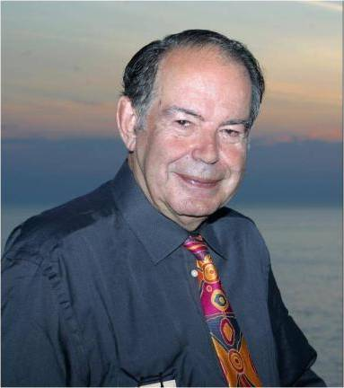
Goals of the program
To learn how to encourage the creative and innovative thinking with students
To motivate students to become proactive, to do something to improve the situation or solve the problem themselves
To get to know the de Bono thinking tools (CoRT)
To develop the skills of the group work and to become tolerant to the views of the others
Dr. Edward de Bono

Slide 4
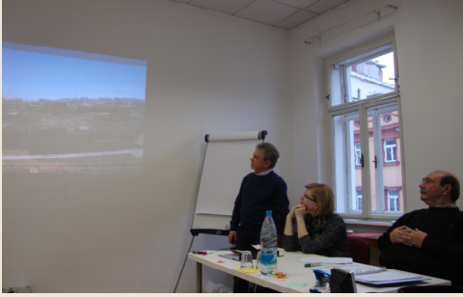
Exchanging information about the schools

Slide 5
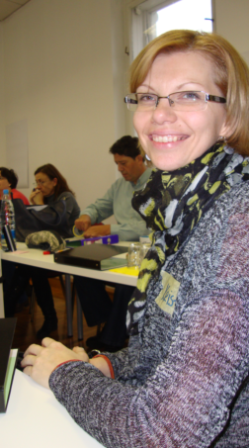
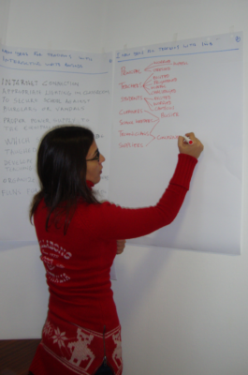
Presenting and sharing creative ideas

Slide 6
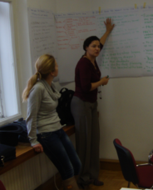
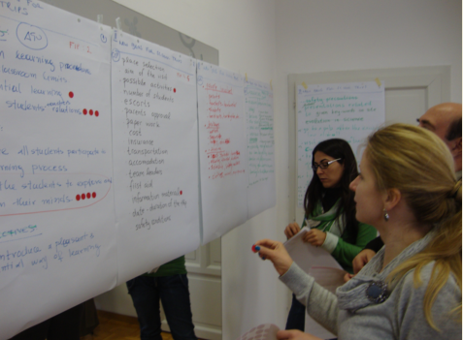
Working in groups

Slide 7
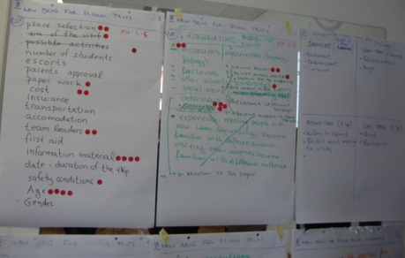
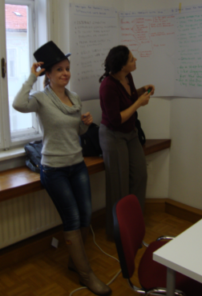
Inspired by de Bono

Slide 8
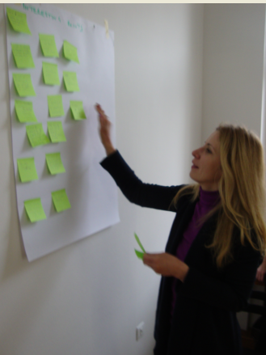
Giving the feedback of the course

Slide 9
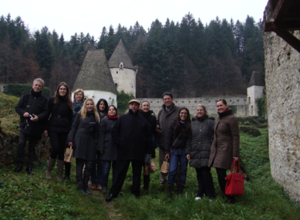
Our group in Slovenia

Slide 10
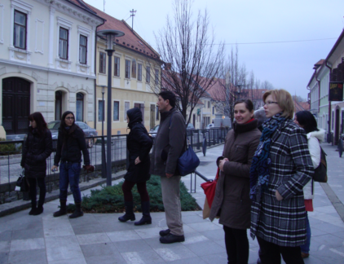
Visiting and exploring the country

Slide 11
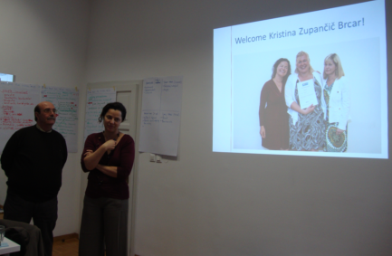
Visiting the schools in Slovenia

Slide 12
The most important things which we found out about the creativity
Positive: Every idea is valuable. All ideas should be recorded.
Prolific: The more ideas, the better. Build on ideas of others.
Playful: It is much easier to tame a wild idea than to make a boring idea interesting.

Slide 13
7 steps to clear thinking by Edward de Bono
1. PMI – Plus, minus, interesting
2. CAF – Considering all factors
3. C&S – Consequences &sequel
4. AGO – Aims, goals, objectives
5. FIP – First important priorities
6. APC – Alternatives, possibilities, choices
7. OPV – Other point of view

Slide 14
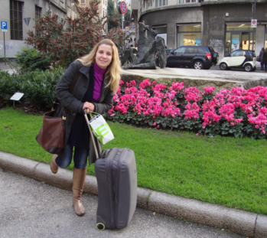
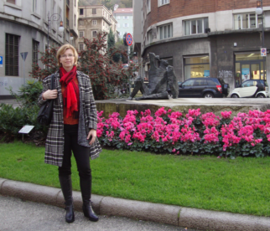
We are ready to implement creative ideas in Riga Teika secondary school
Have a good thinking ☺

