Slide 1


Erasmus+ Mobility
Richard Language College
3.11.-7.11.2014.
Helēna Briede
Daiga Udrase

Slide 2
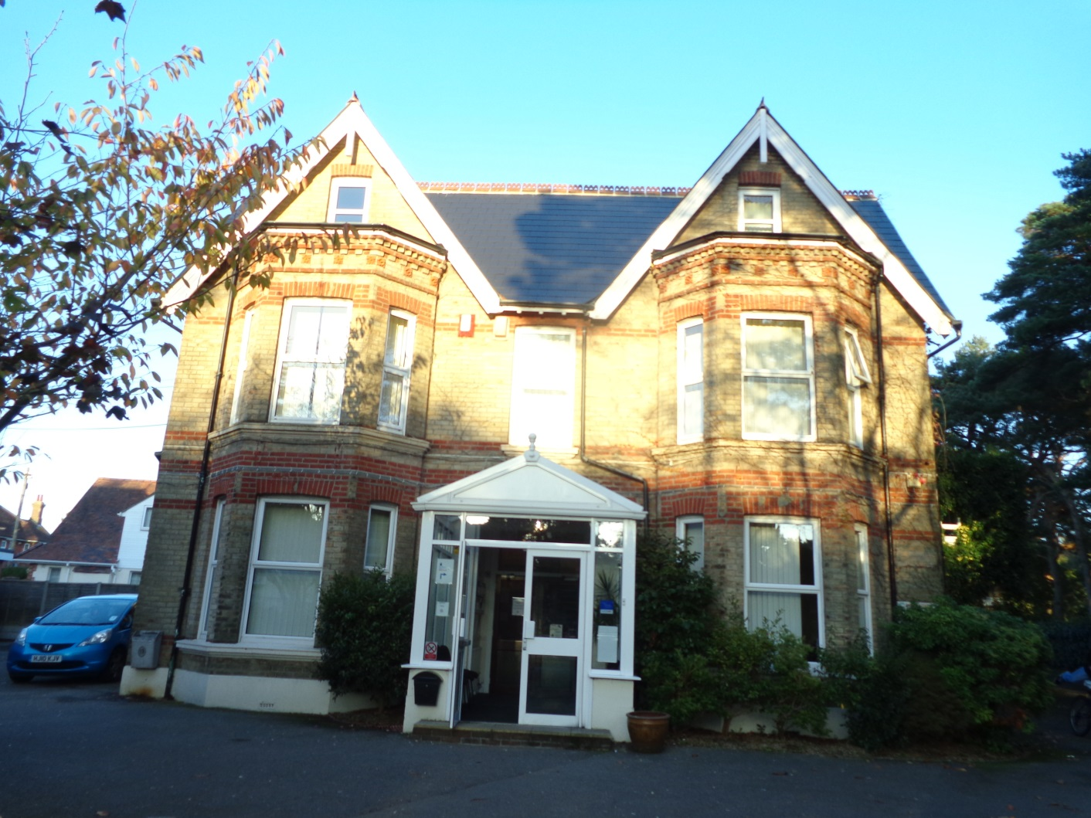
Richard Language college has over 40 years experience in language teaching, examining, course design, linguistic profiling, teacher training, school management, school inspection and curriculum innovation in English as a Foreign Language.

Slide 3
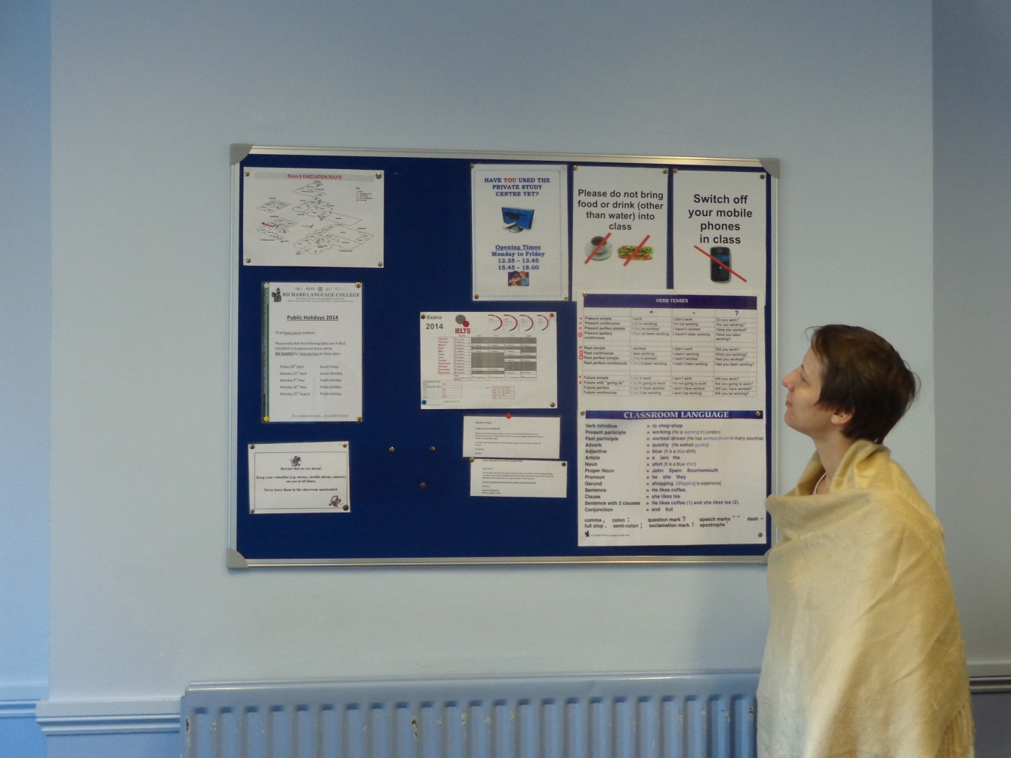
Welcome
Testing and Evaluation
RLC Orientation

Slide 4
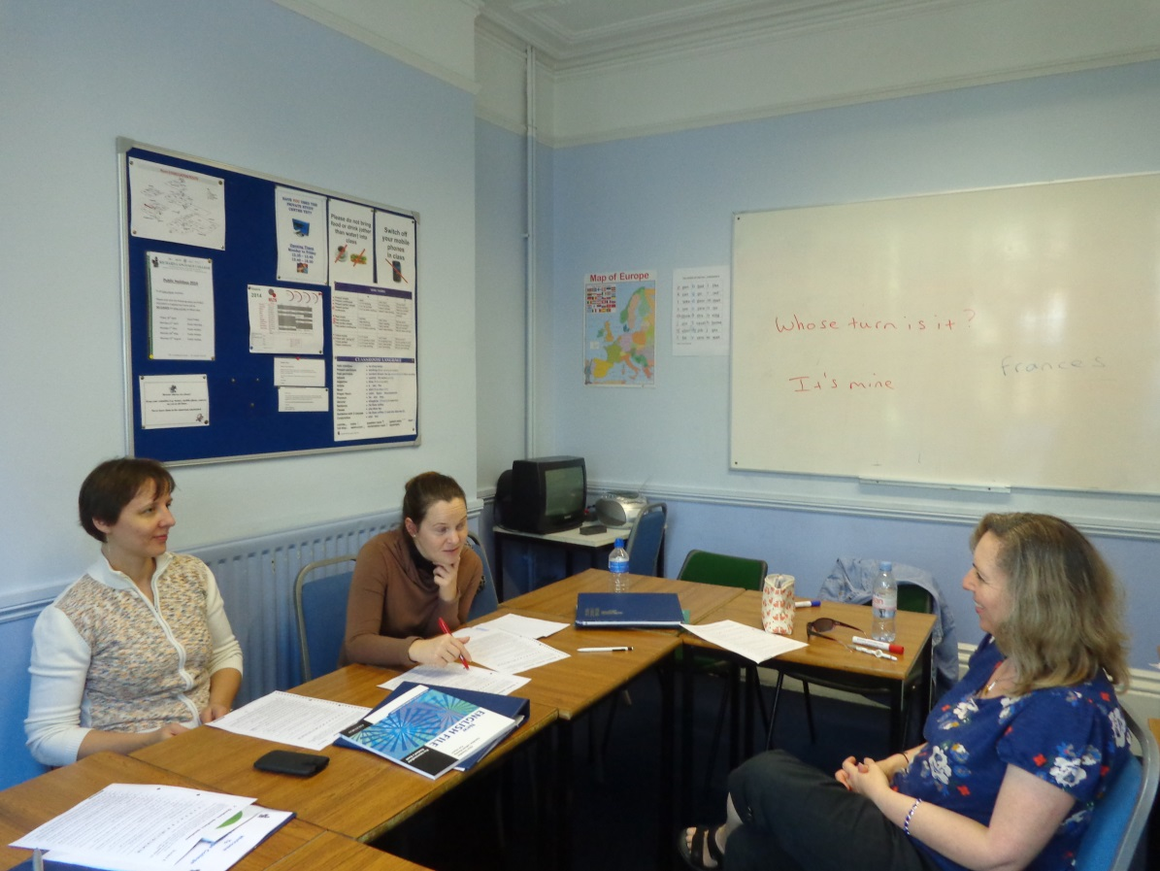
Lessons were focused on practising and developing listening and speaking skills

Slide 5
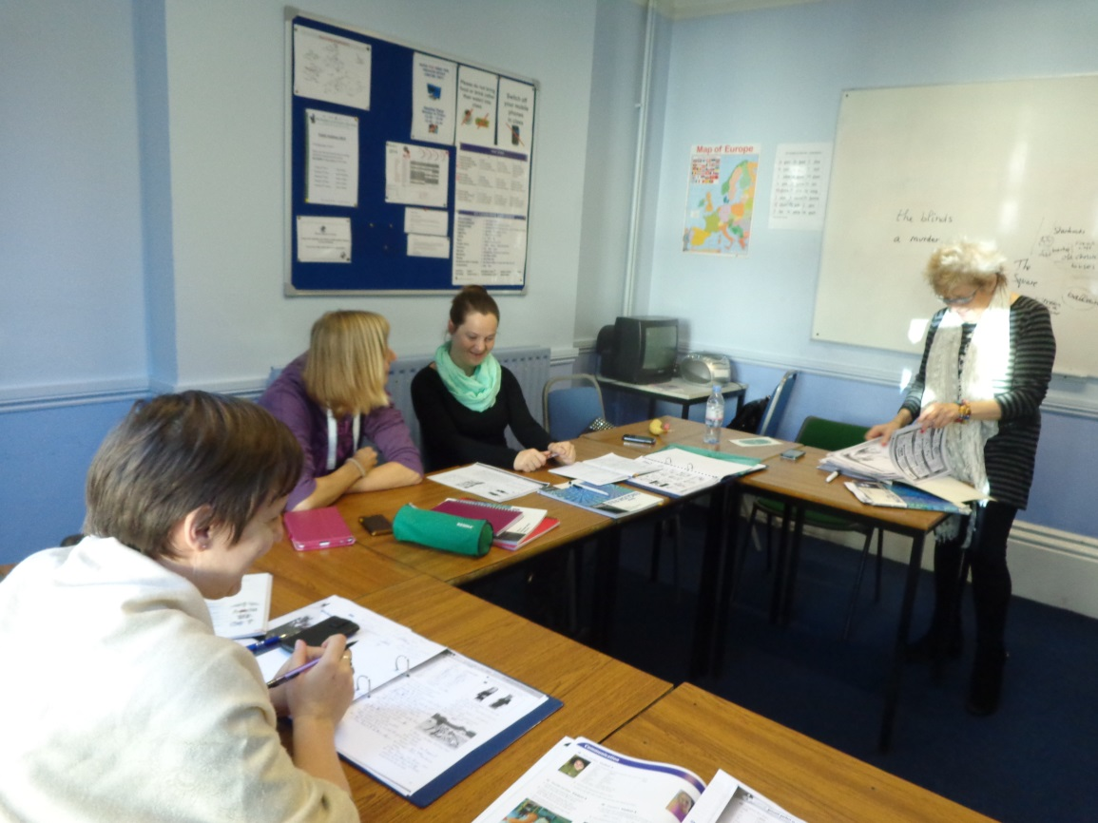
Lessons were topic based with new vocabulary being presented through a variety of listening, speaking and reading tasks.

Slide 6
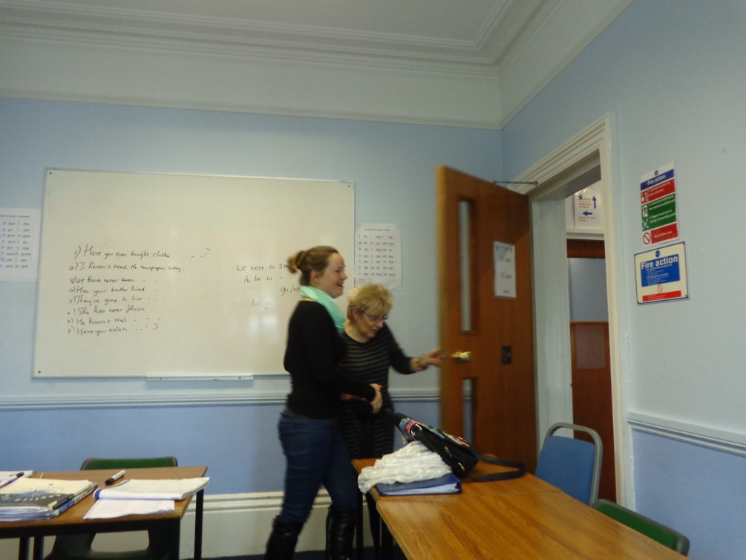
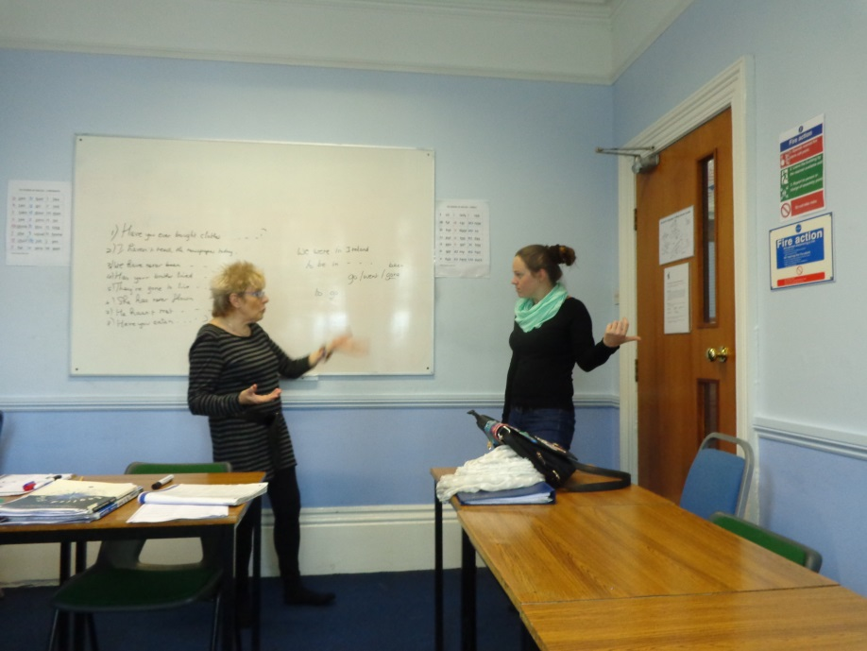
The lessons followed an integrated approach to enable all 4 skills (reading, writing, listening and speaking) to be developed.

Slide 7
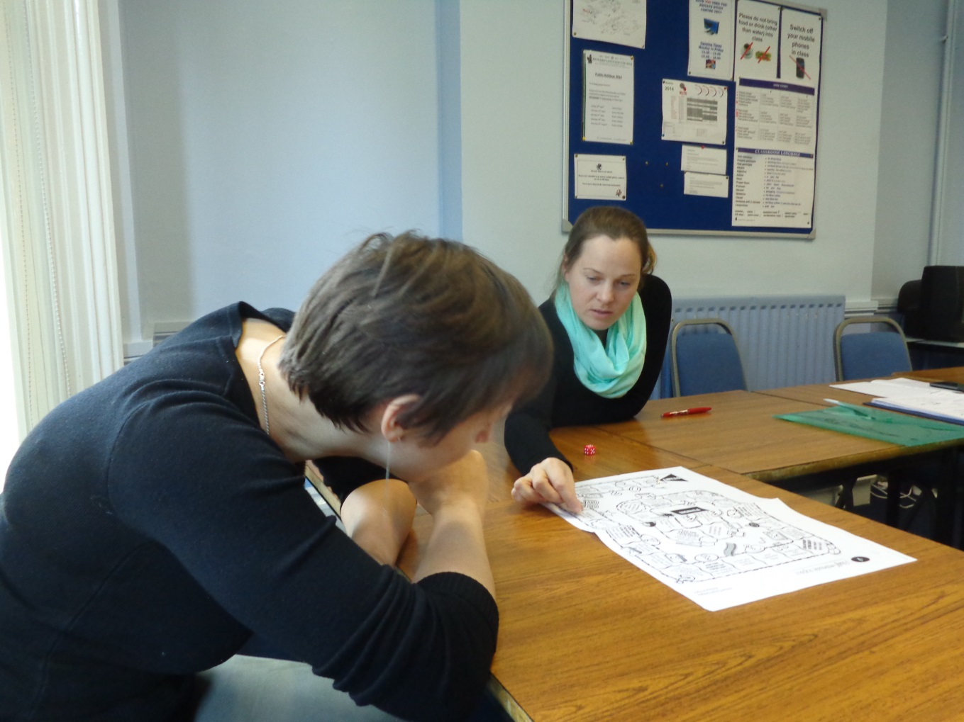
Morning lessons involved grammar presentation and practise, as well as activities to help with the acquisition of key vocabulary.

Slide 8
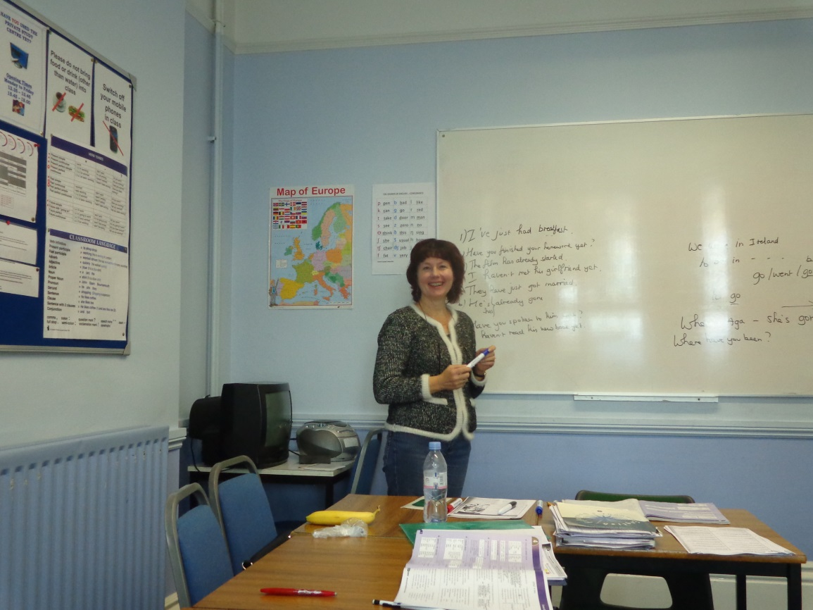
Academic English skills were practised with the emphasis on developing reading and writing skills.

Slide 9
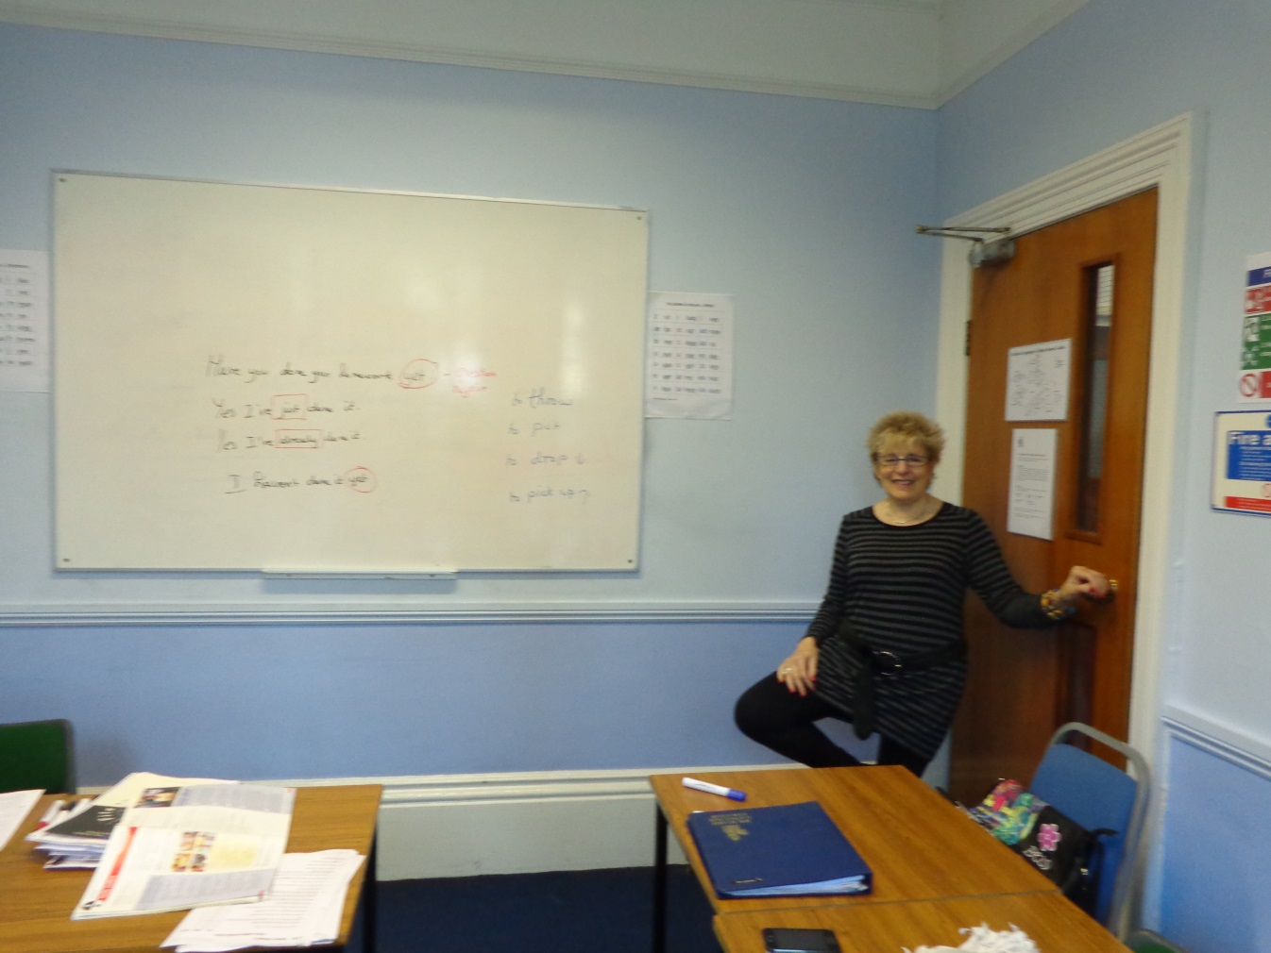
There must be a sporty break….

Slide 10
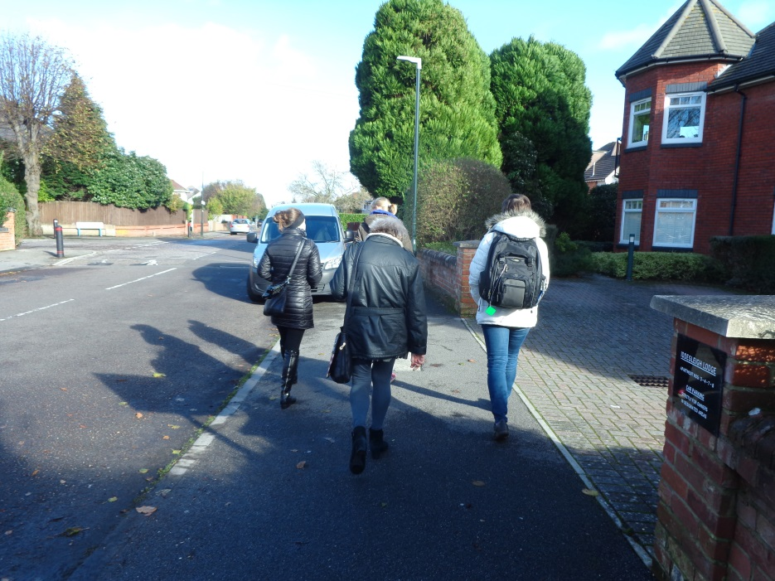
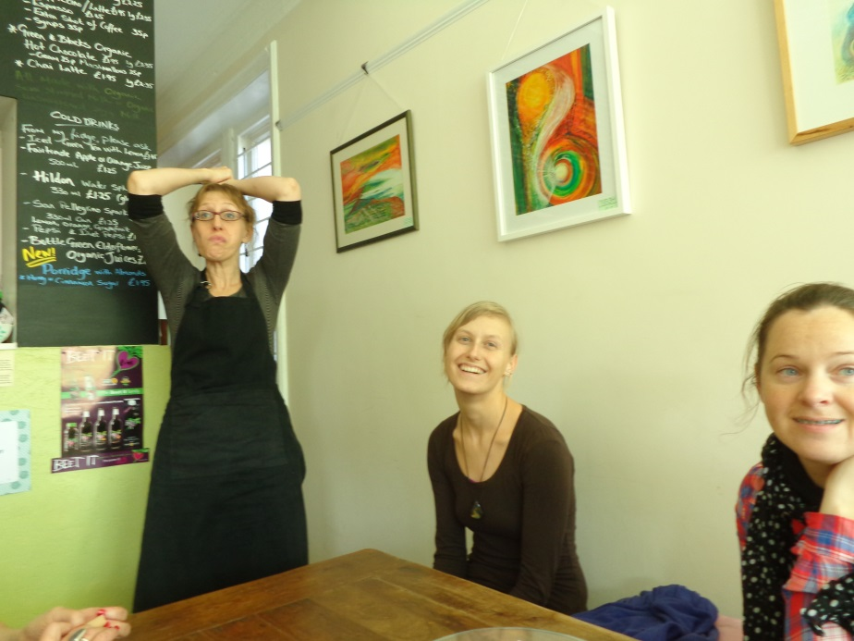
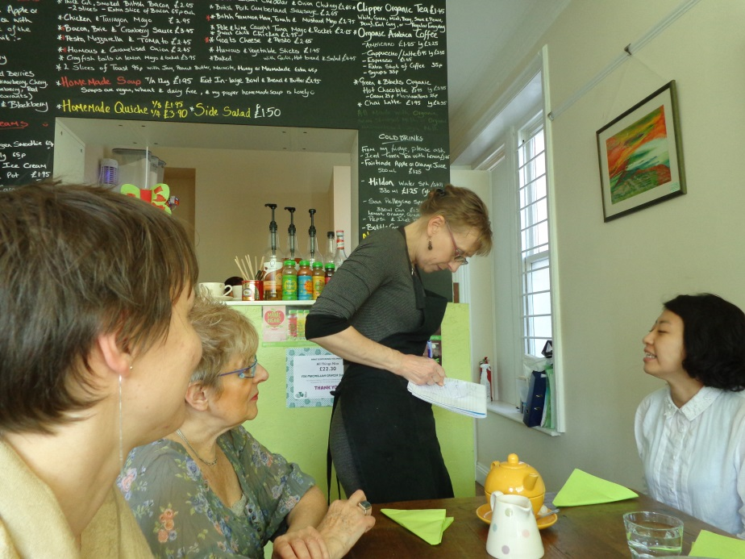
Practical and innovative leassons in a real environment

Slide 11
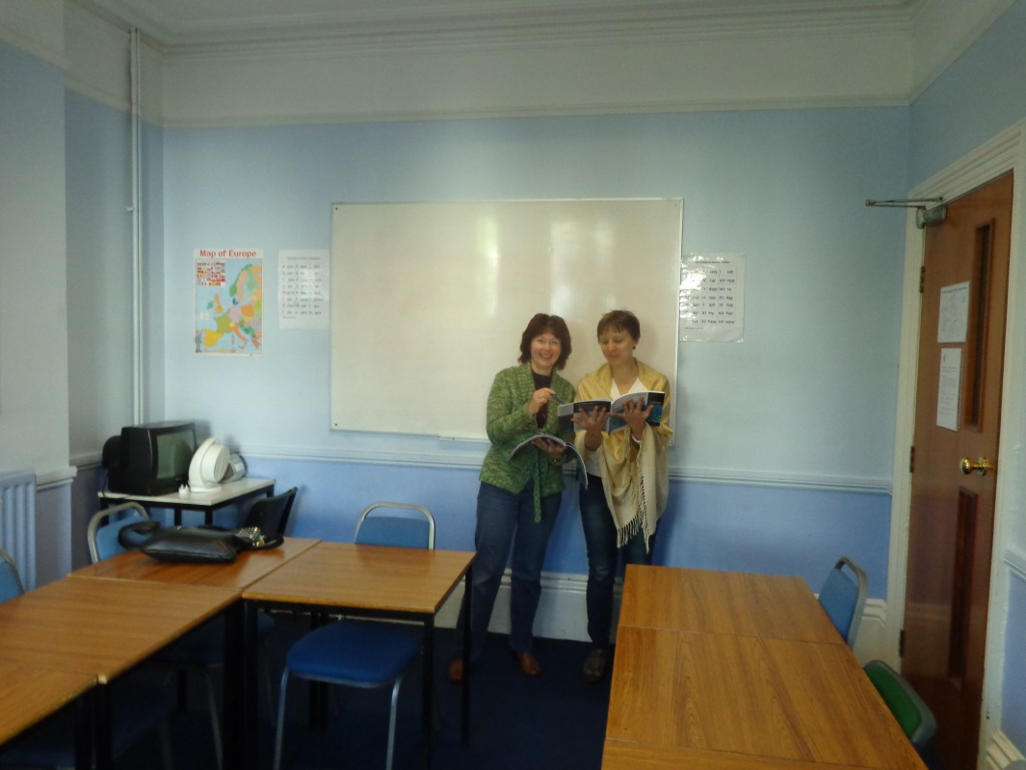
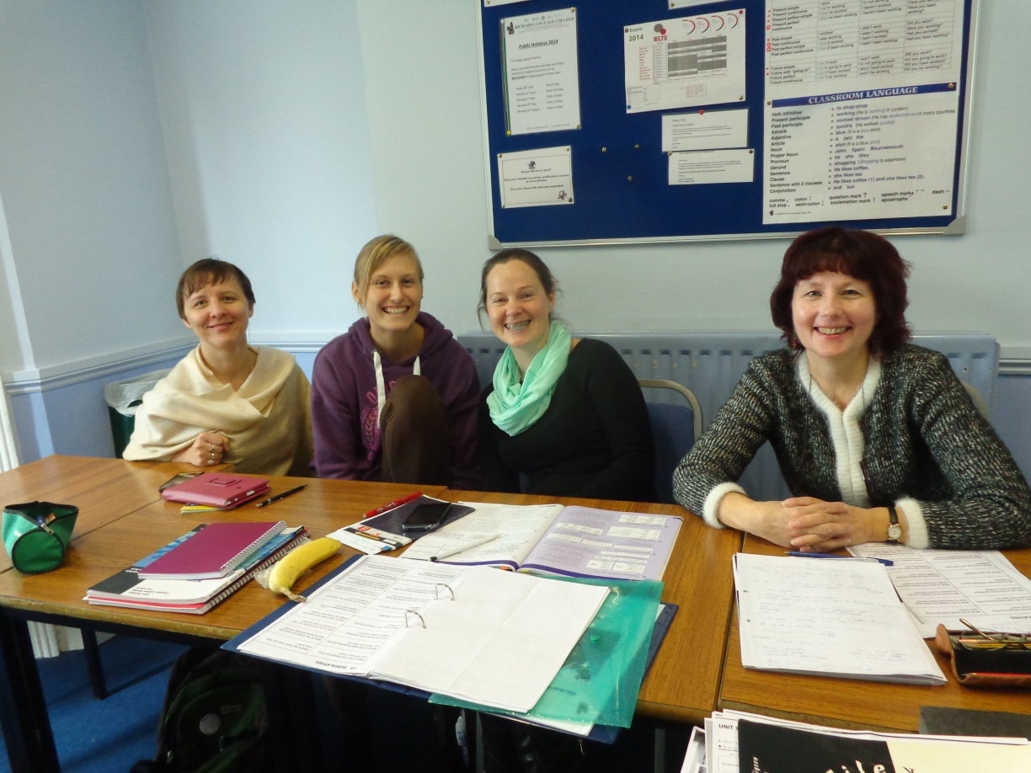
Students have regular tutorials with their teachers to discuss their progress and ways to maximise their learning.

