Slide 1
Using innovative teaching methods
Lauma Salmane
Teacher of Nature sciences

Slide 2
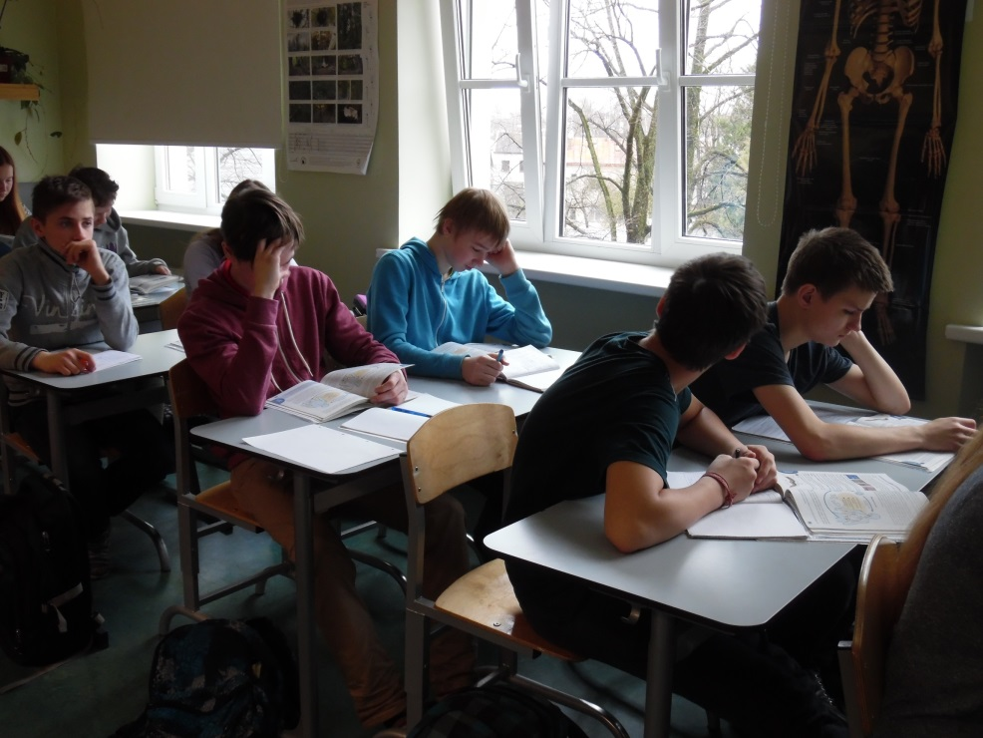
Usage of visual aids
I use a lot of video materials in my work, that I have found on the internet in foreign languages that are good for representing curriculum visually to back up learning from these videos. Such way we look up the appropriate terminology, analyse what we see in the videos and animations.

Slide 3
For example, cell splitting – its phases, components
and proceses

Slide 4
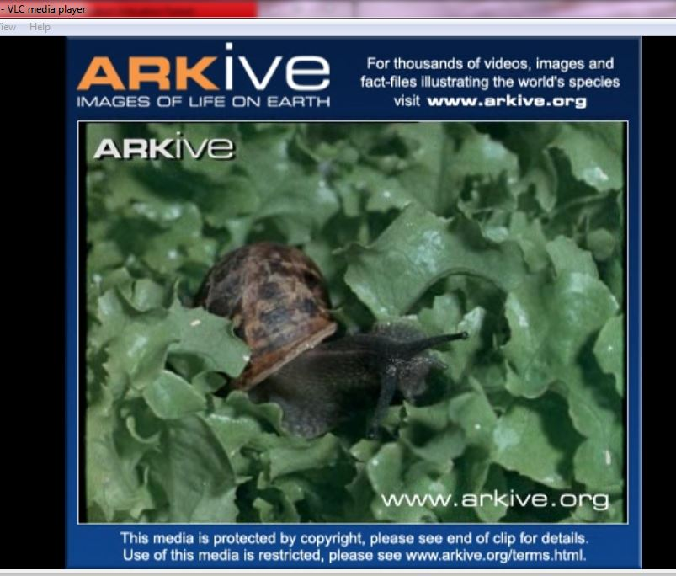
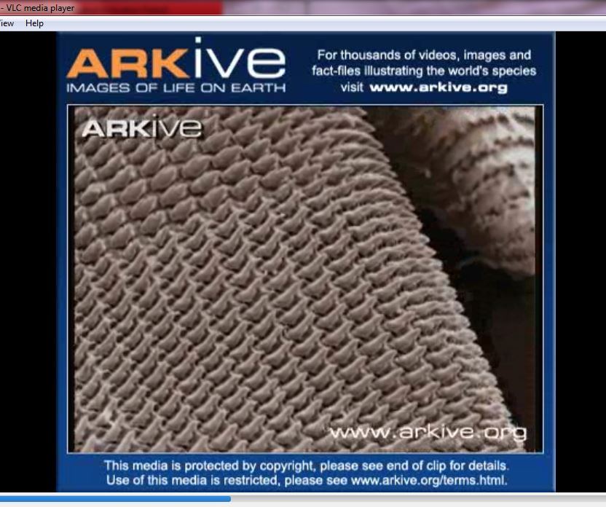
Or watching a video about snail – we look up the neccessary information in books, like that it uses its tongue to eat plants

Slide 5
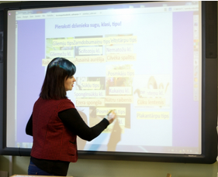
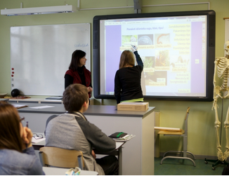
Usage of information technologies
I have created interactive learning materials for Active Inspire environment

Slide 6
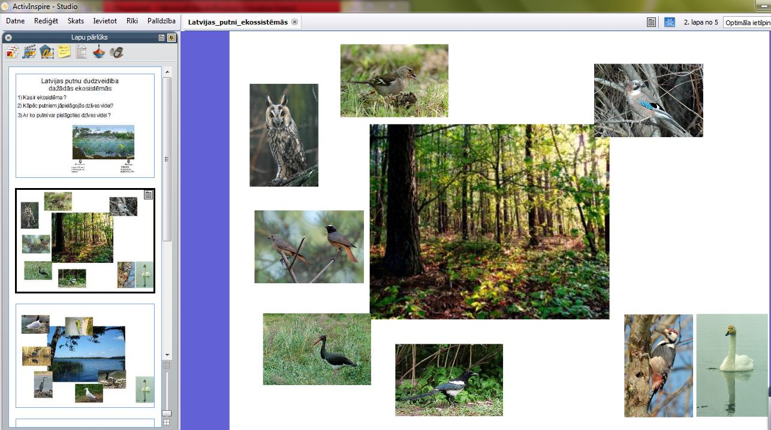
Visual aids – explaining new curriculum
for example, fruit types and their classification of birds in Latvia in different ecosystems

Slide 7
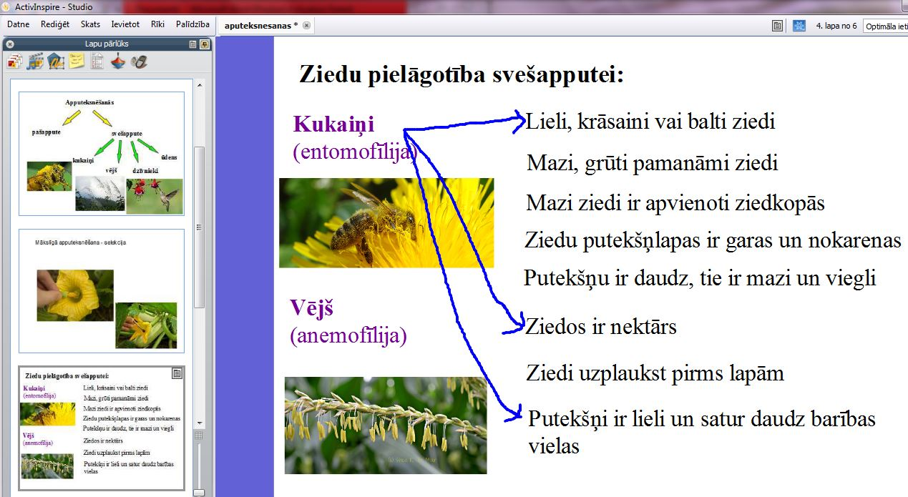
Testing students knowledge
for example, linking definitions to their explanations

Slide 8
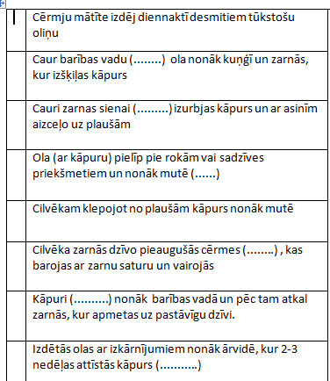
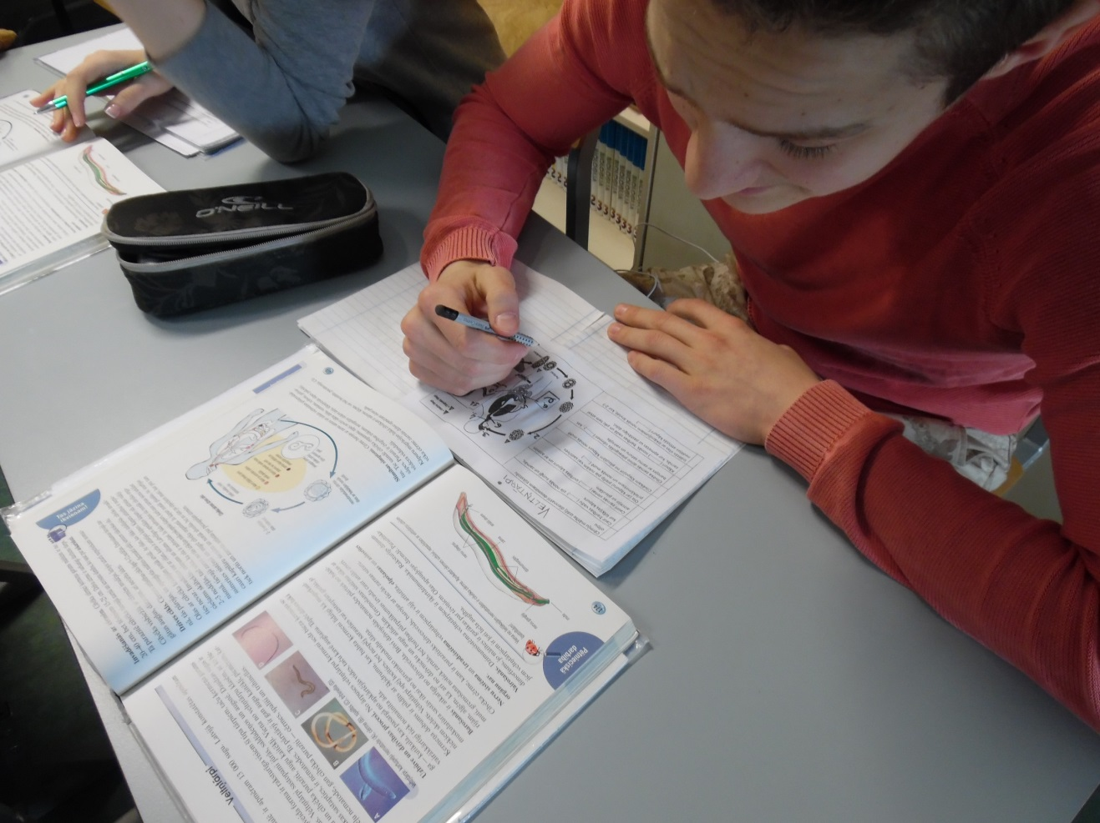
Gap filling tasks with the missing words

Slide 9
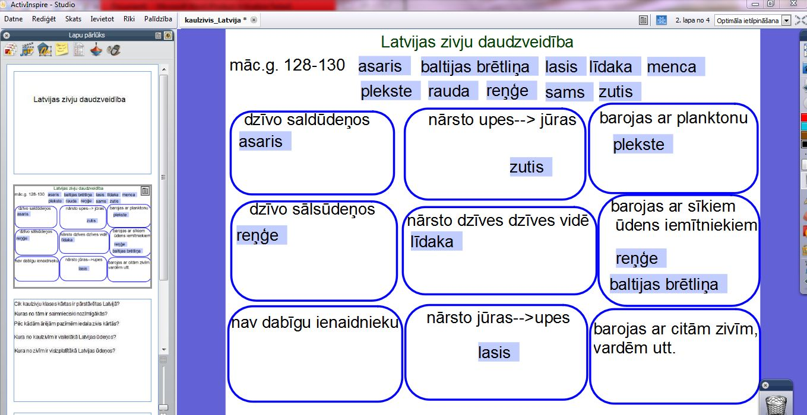
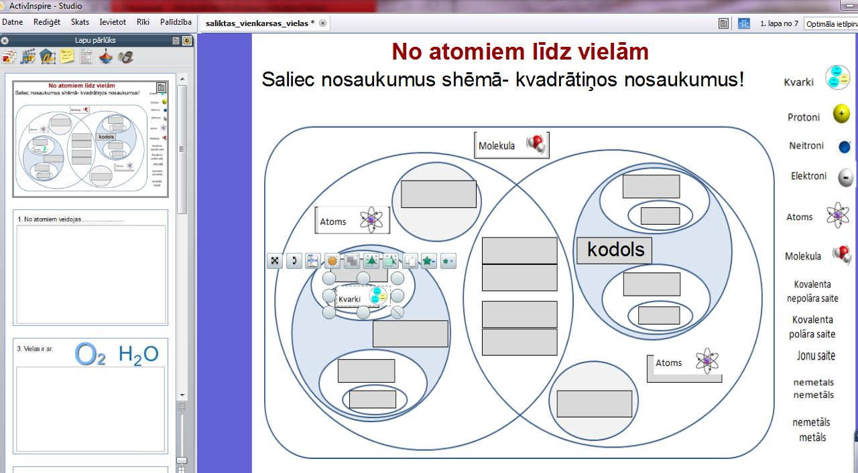
Work for pairs and single students at the
interactive board
for example, fish diversity, moleculestructure from quarks to atoms

Slide 10
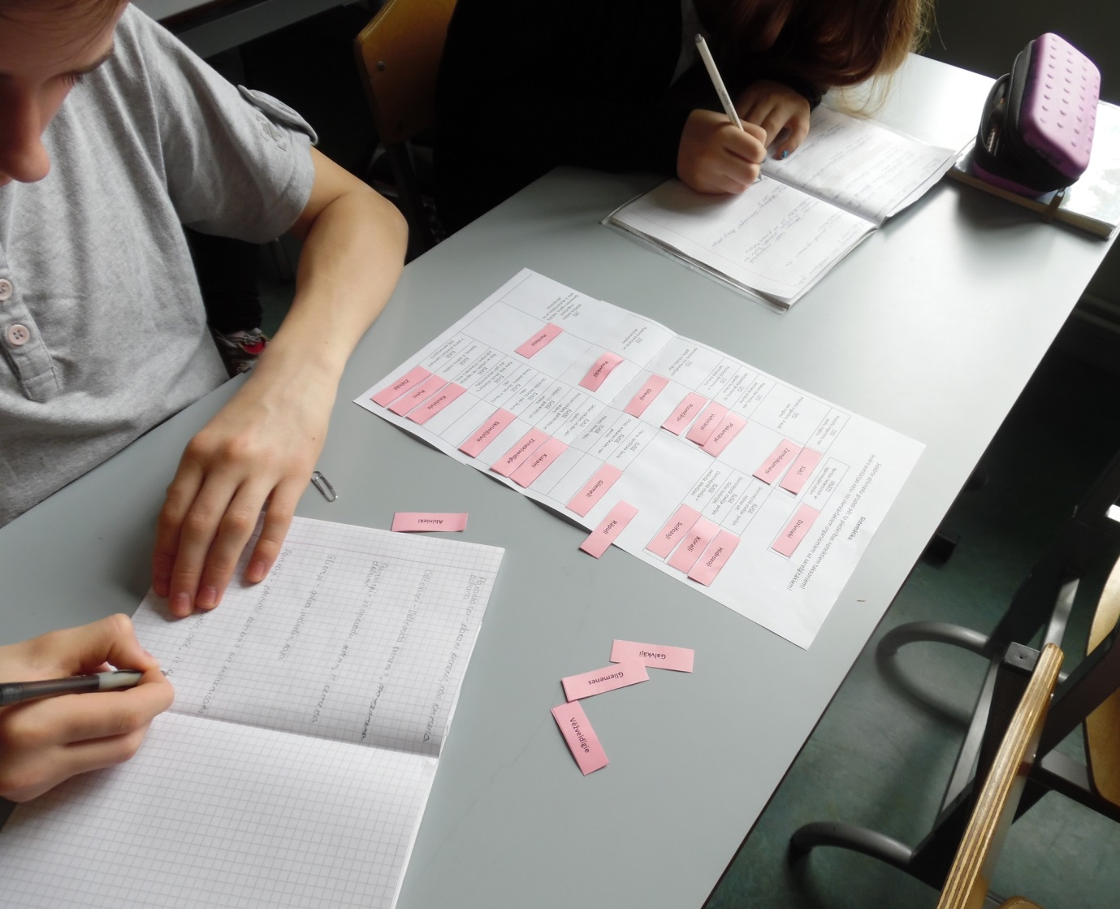
Work with handouts
Sort definitions, concepts and create schemes

Slide 11
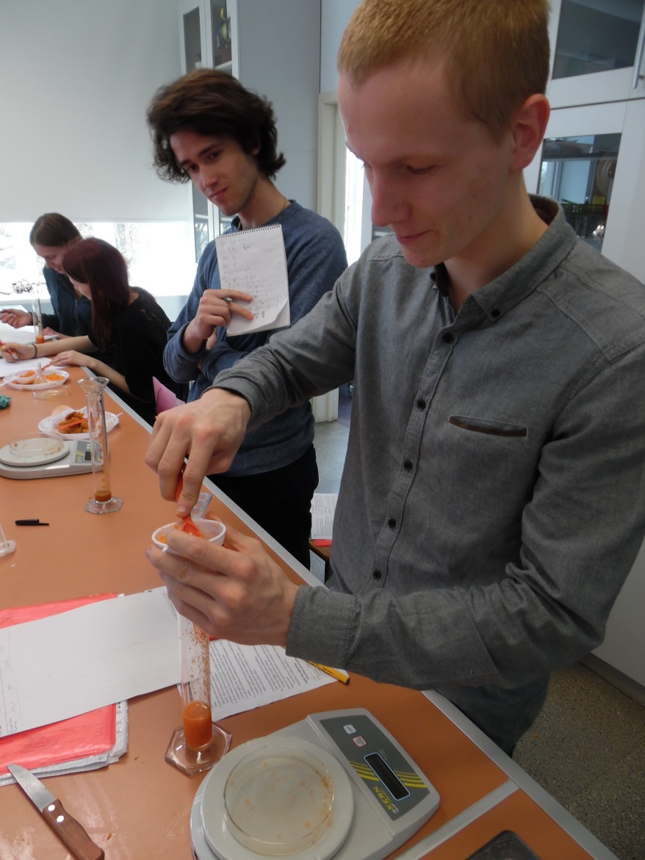
Research work
We work on projects, to prove that what is learned in theory works in real life as well.

Slide 12
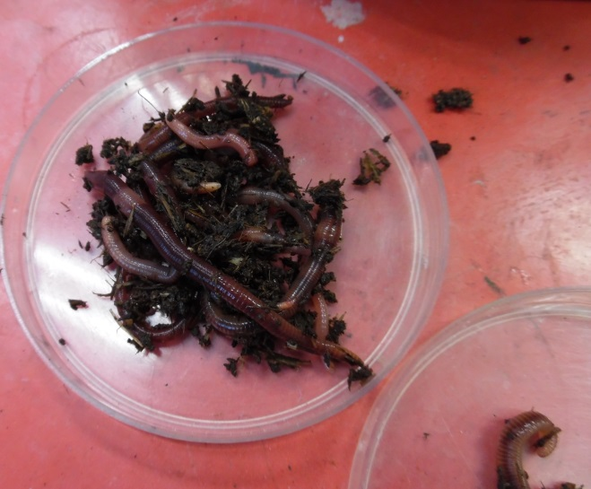
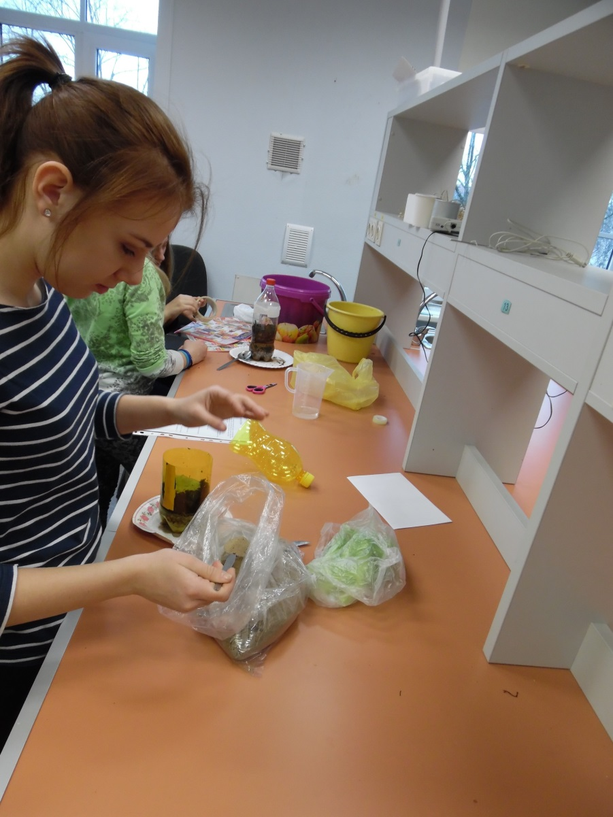
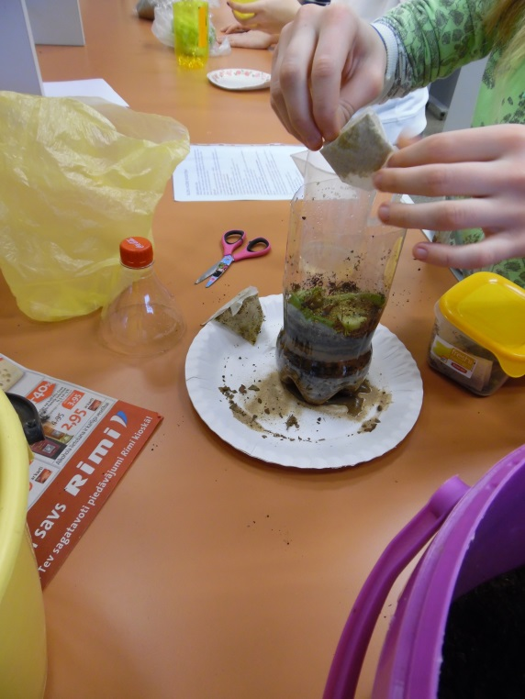
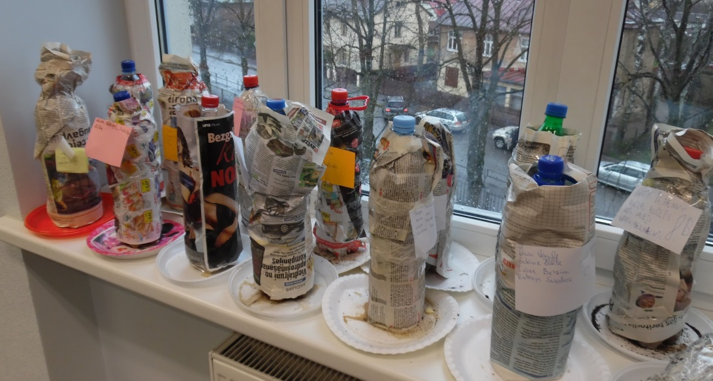
For example, worms importance in exosystem.

Slide 13
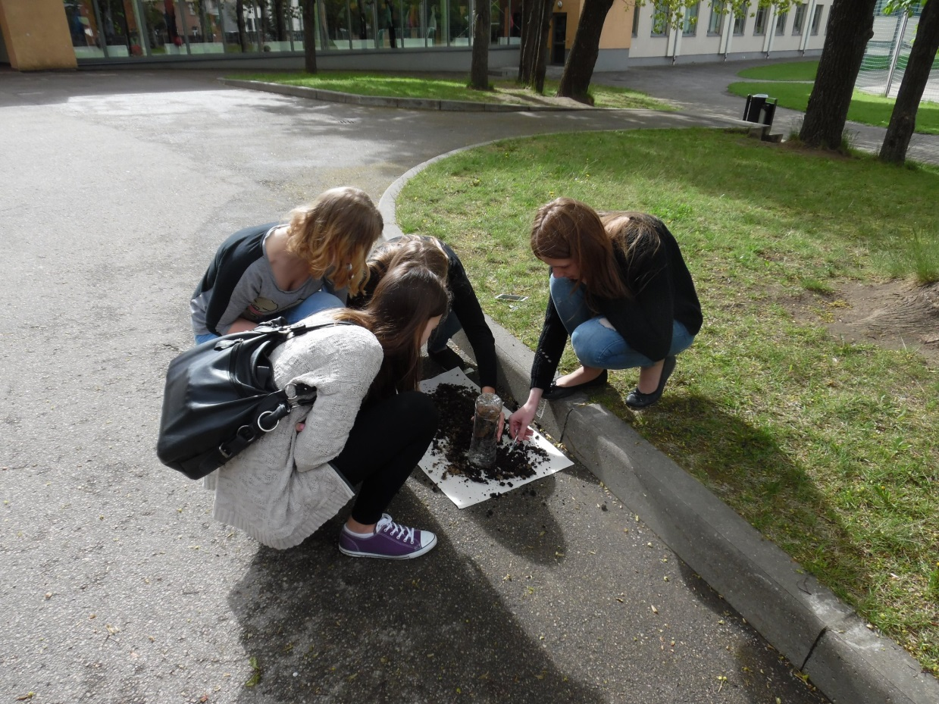
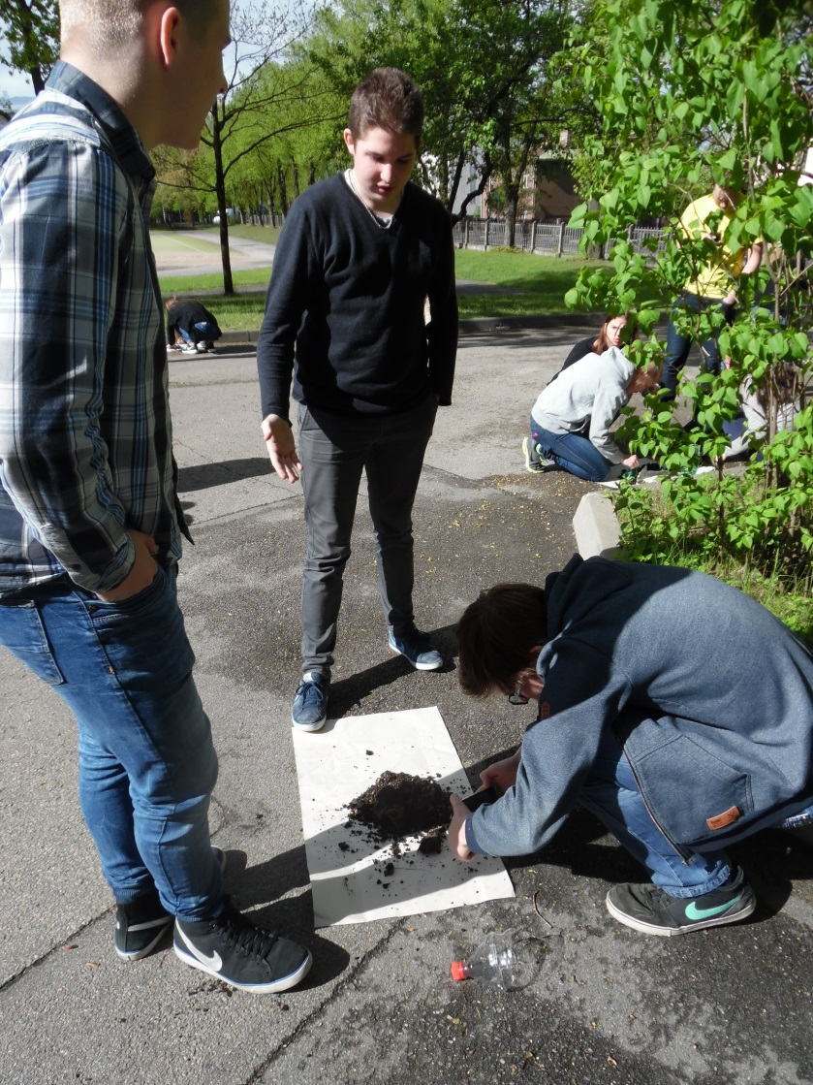
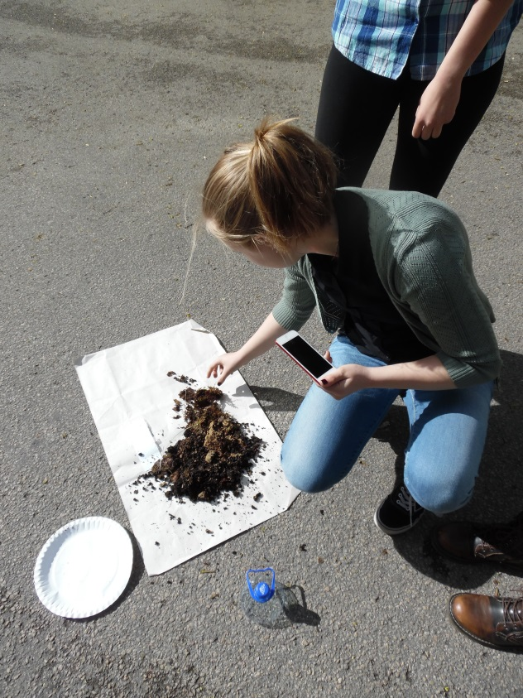

Slide 14
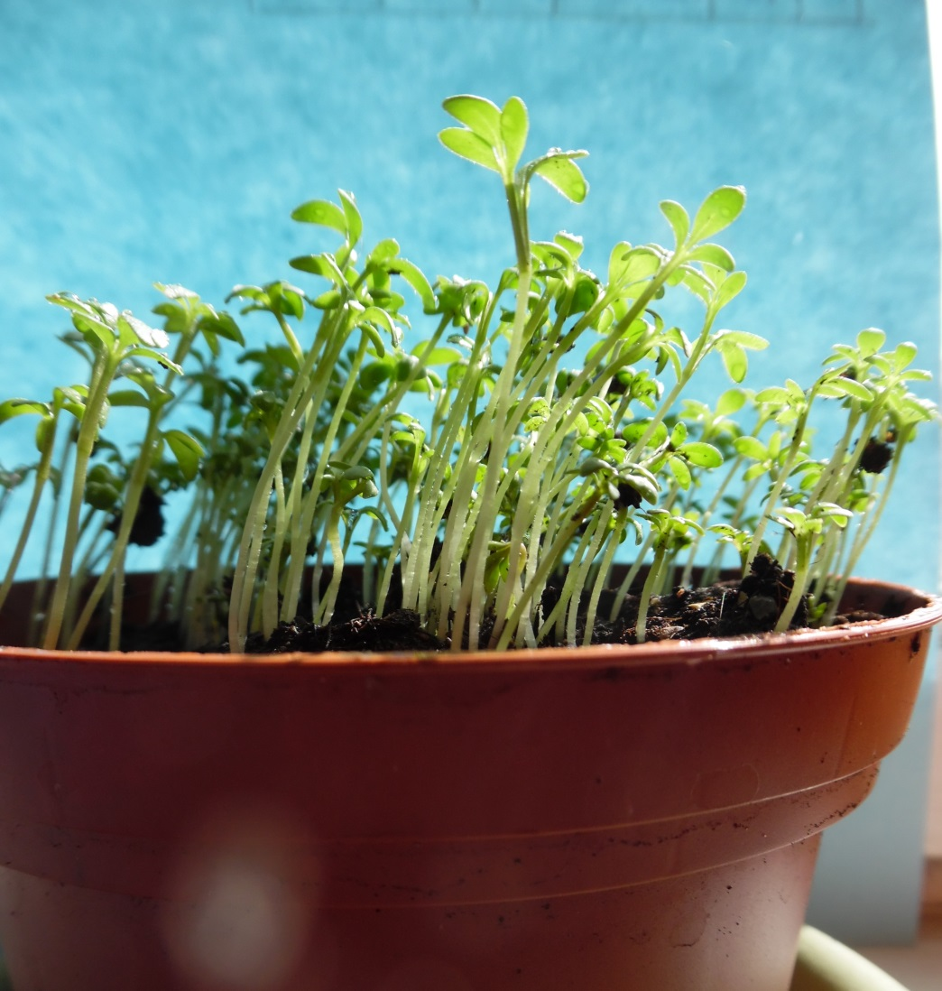
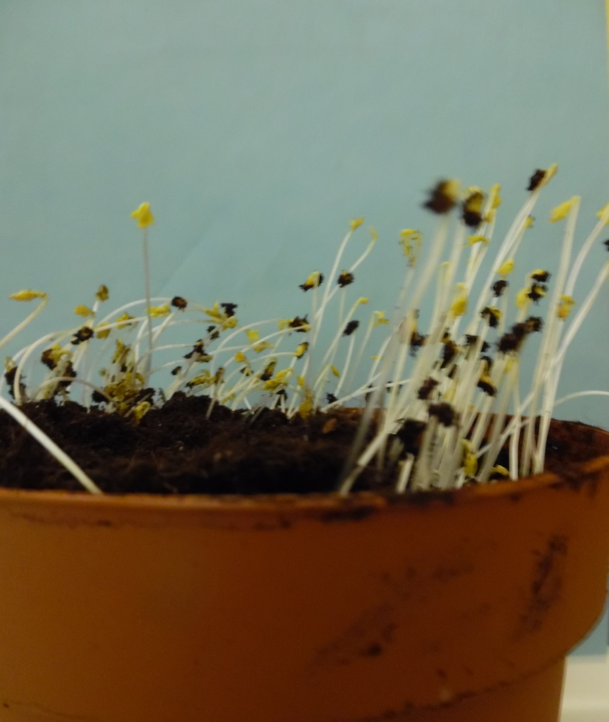
Exploring plants necessity for daylight

Slide 15
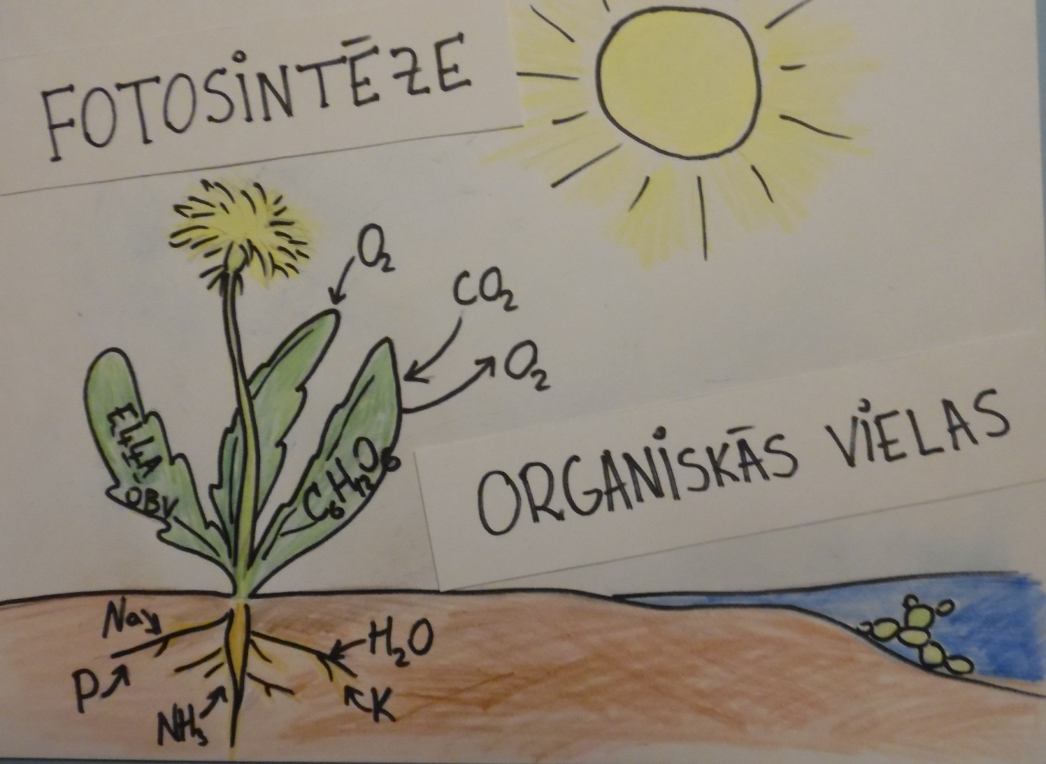
After doing so students share their findings and
explain what they have learned

Slide 16
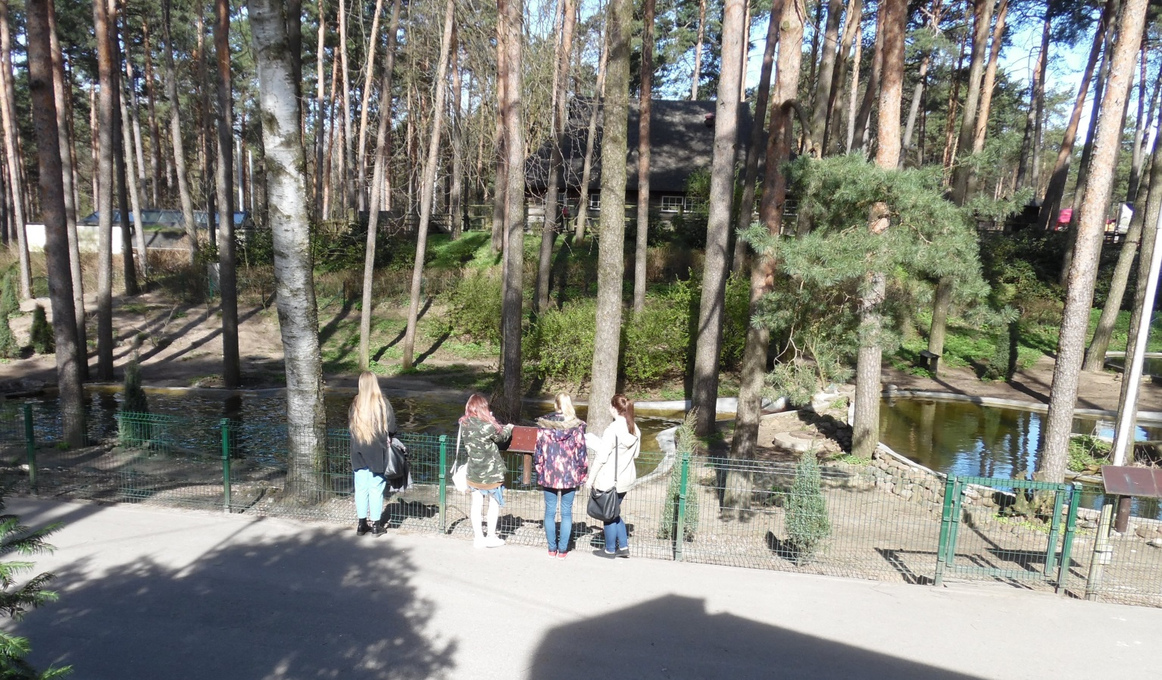
Outdoor studies
In study excursions we do group work with worksheets, where students complete variety of tasks – look up information, count, tkae pictures, compare

Slide 17
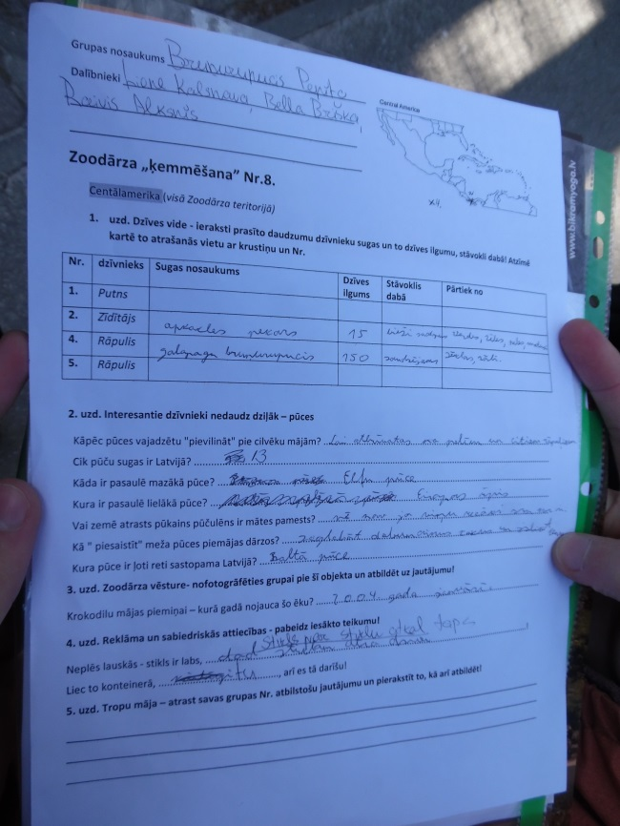
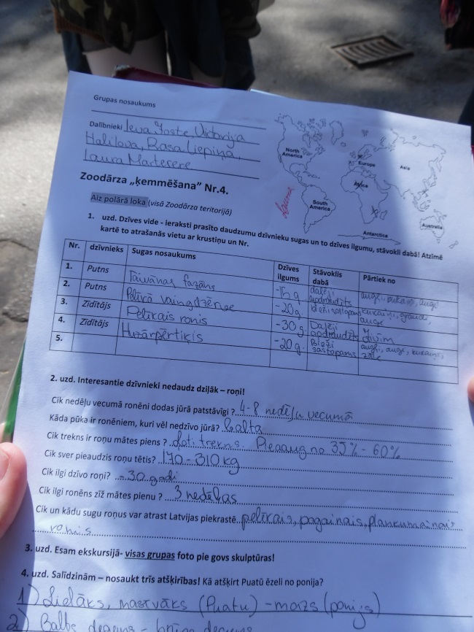
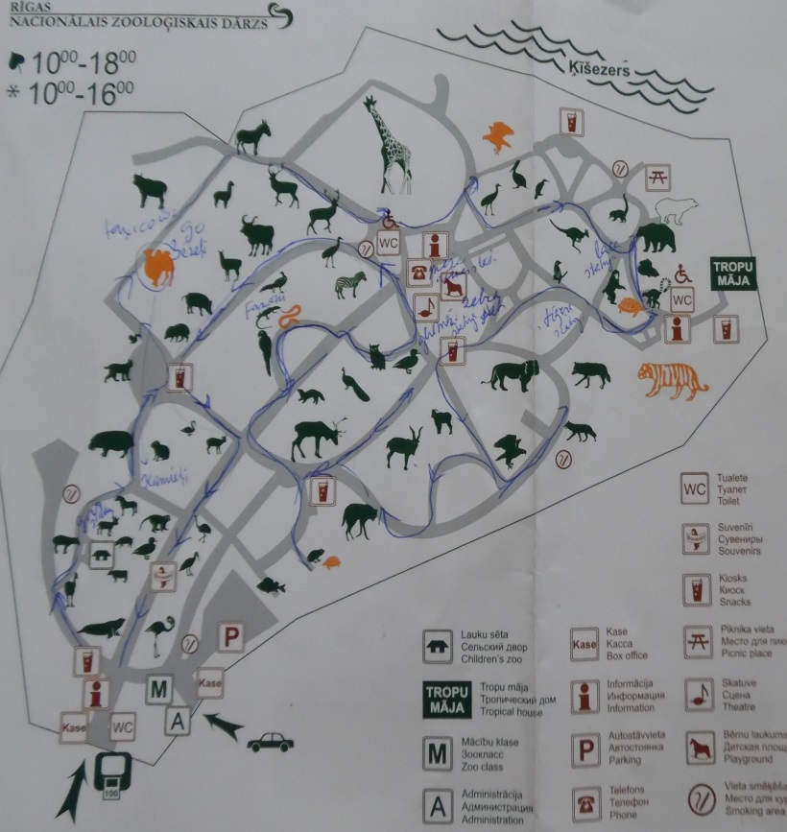
For example, study excursion to Riga Zoo – where students where split into ten groups and each had its own tasks.

Slide 18
Thank you for your attention!

